Slide 1
Algorithm Design & Analysis Introduction to Algorithm
Chapter 2: Getting Started: Analyzing Algorithms
《算法分析与设计》课程组
重庆大学计算机学院
Notes:
In Chapter 2, we see our first algorithms, which solve the problem of sorting a sequence of n numbers. They are written in a pseudocode which, although not directly translatable to any conventional programming language, conveys the structure of the algorithm clearly enough that a competent programmer can implement it in the language of his choice. The sorting algorithms we examine are insertion sort, which uses an incremental approach, and merge sort, which uses a recursive technique known as "divide and conquer." Although the time each requires increases with the value of n, the rate of increase differs between the two algorithms. We determine these running times in Chapter 2, and we develop a useful notation to express them.

Slide 2
Getting Started: Analyzing Algorithms
OUTLINE
2.0 Analysis of algorithms: Why & What?
2.1 Insertion Sort: Example!
Description & analyzing algorithms?
2.2 Analyzing algorithms: How?
2.3 Designing algorithms: How?
Divide-and-Conquer
Merge Sort
Time complexity for Divide-and-Conquer
Notes:
2

Slide 3
2.0 Analysis of algorithms
What are analysis of algorithms?
The theoretical study of computer-program performance and resource usage.
What’s more important than performance?
Modularity • correctness • maintainability
Functionality • robustness • user-friendliness
programmer time • simplicity • extensibility
reliability

Slide 4
Criteria for analysis of algorithms
We will use the following criteria:
Correctness
Amount of work done
Amount of space used
Simplicity
Optimality

Slide 5
Correctness
Correctness:
An algorithm is correct if when given a valid input it computes for a finite amount of time and produces the right answer.
This definition is helpful if we know what the valid inputs are and what “the right answer” is.
Thus showing that an algorithm is correct means making a precise statement about what result it is to produce when given certain specified inputs, and then proving the statement.

Slide 6
Amount of work down: Efficiency
Run time = depend on the follow factors:
Computing model: RAM (random-access machine): How many computers?
In the RAM model, instructions are executed one after another, with no concurrent operations.
Instructions contained in RAM model
Machine: CPU How fast is the computer?
Input: Scale of instance How many data?
Number of basic operations done

Slide 7
Amount of space used
The number of memory cells used by a program:
Prediction of the adequacy of memory space for running a program
Allocation of memory for programs in multiuser system
Estimation of the size of the problems that can be solved

Slide 8
Simplicity
Simplicity
It is often, though not always, the case that the simplest and most straightforward way of solving a problem is not the most efficient. Yet simplicity in an algorithm is a desirable feature.
It may make verifying the correctness of the algorithm easier, and it makes writing, debugging, and modifying a program for the algorithm easier.
The time needed to produce a debugged program should be considered when choosing an algorithm, but if the program is to be used very often, its efficiency will probably be the determining factor in the choice.

Slide 9
Optimality
We say that an algorithm is optimal (in the worst case) if there is no algorithm in the class under study that performs fewer basic operations (in the worst case).
How would you know it?

Slide 10
2.1 Insertion Sort
The problem of sorting: Description
Insertion sort: Algorithm description

Slide 11
The Problem of sorting: Description
Sorting problem:
Input: A sequence of n numbers a₁, a₂, ..., a_{n}
Output: A permutation (reordering) a'₁, a'₂, ..., a'_{n} of the input sequence such that
a'₁≤ a'₂ ≤ ... ≤ a'_{n}
An instance of the sorting problem
Input: 8 2 4 9 3 6
Output: 2 3 4 6 8 9
Notation:
Sorting is a fundamental operation in CS
A large number of good sorting algorithms have been D&R

Slide 12
Game: Sorting a hand of cards?
Game
Task: Sorting a hand of cards
Input: a suit of play cards
Output: sorted cards
Requirement: as Fast as possible?
Report: The sorting method | algorithm?

Slide 13
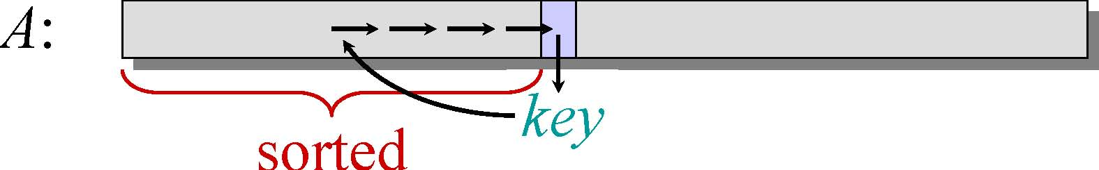
Example of insertion sort
8 2 4 9 3 6
• Initialization:
• Maintenance:
Insert A[j] into the sorted sequence A[1 j - 1].
• Termination:
• Why an algorithm is correct？ Induction

Slide 14
Insertion sort: Algorithm description
INSERTION-SORT (A, n) // A[1 . . n]
“pseudocode”
for j ← 2 to n
do key ← A[ j]
// Insert A[j] into the sorted sequence A[1 j - 1].
i ← j – 1
while i > 0 and A[i] > key
do A[i+1] ← A[i]
i ← i – 1
A[i+1] = key

Slide 15
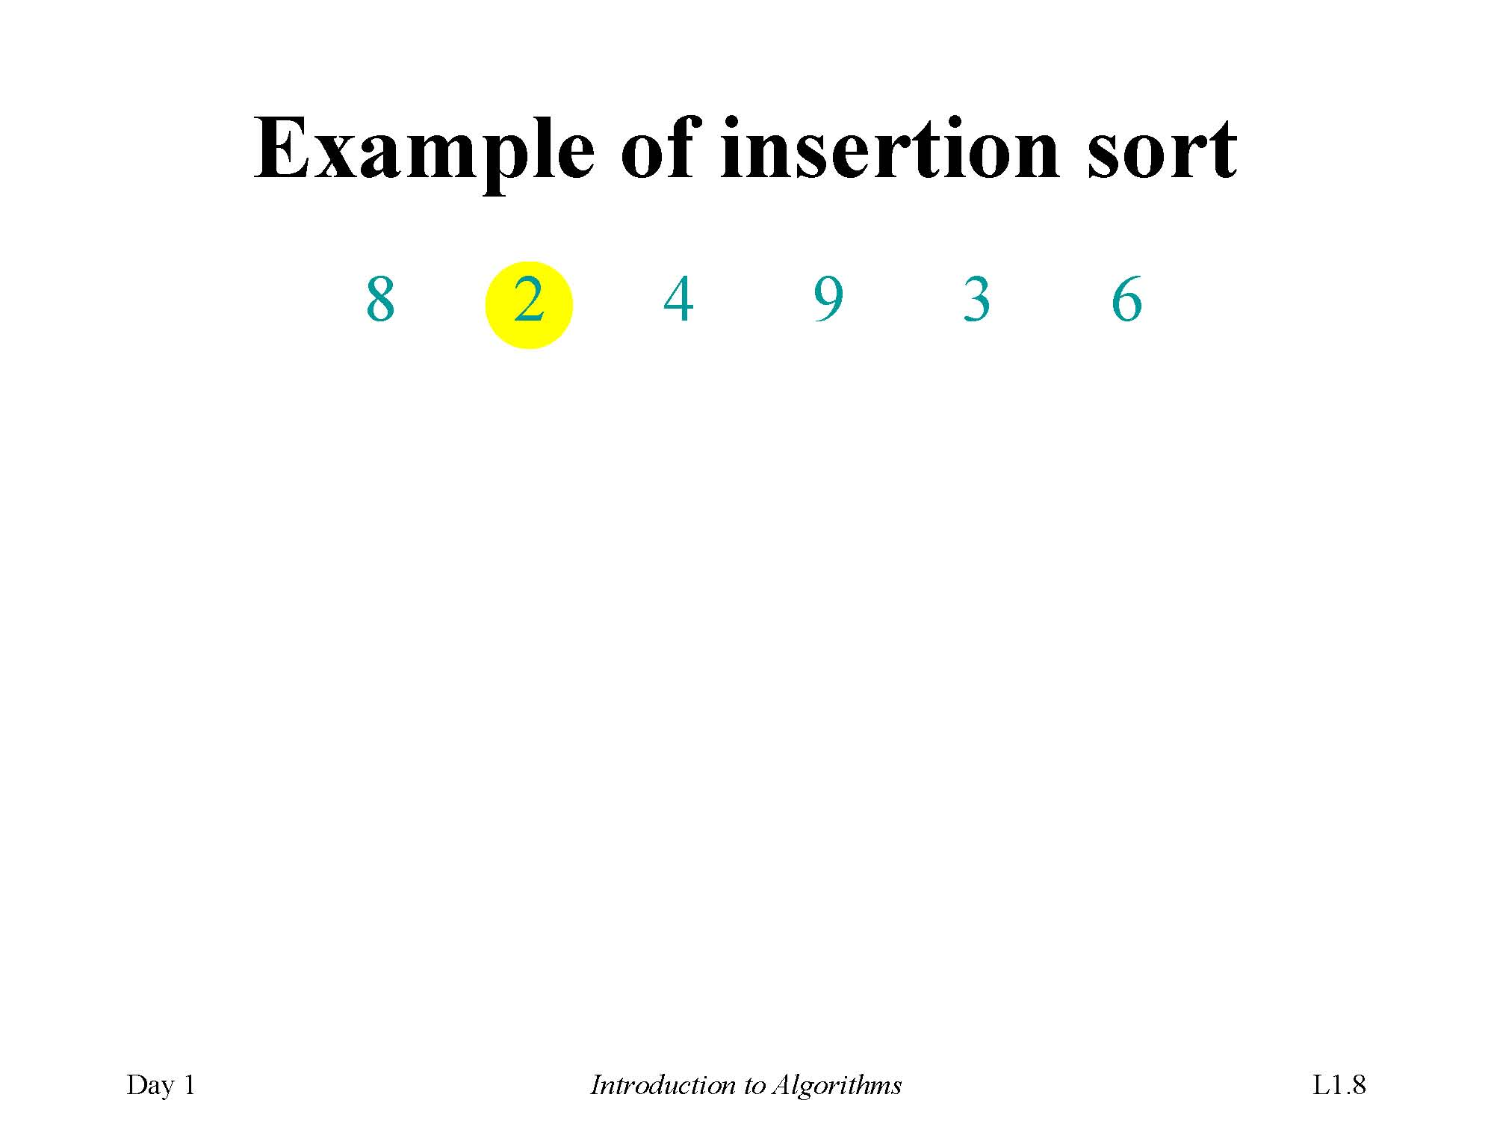
Example of insertion sort

Slide 16
Example of insertion sort

Slide 17
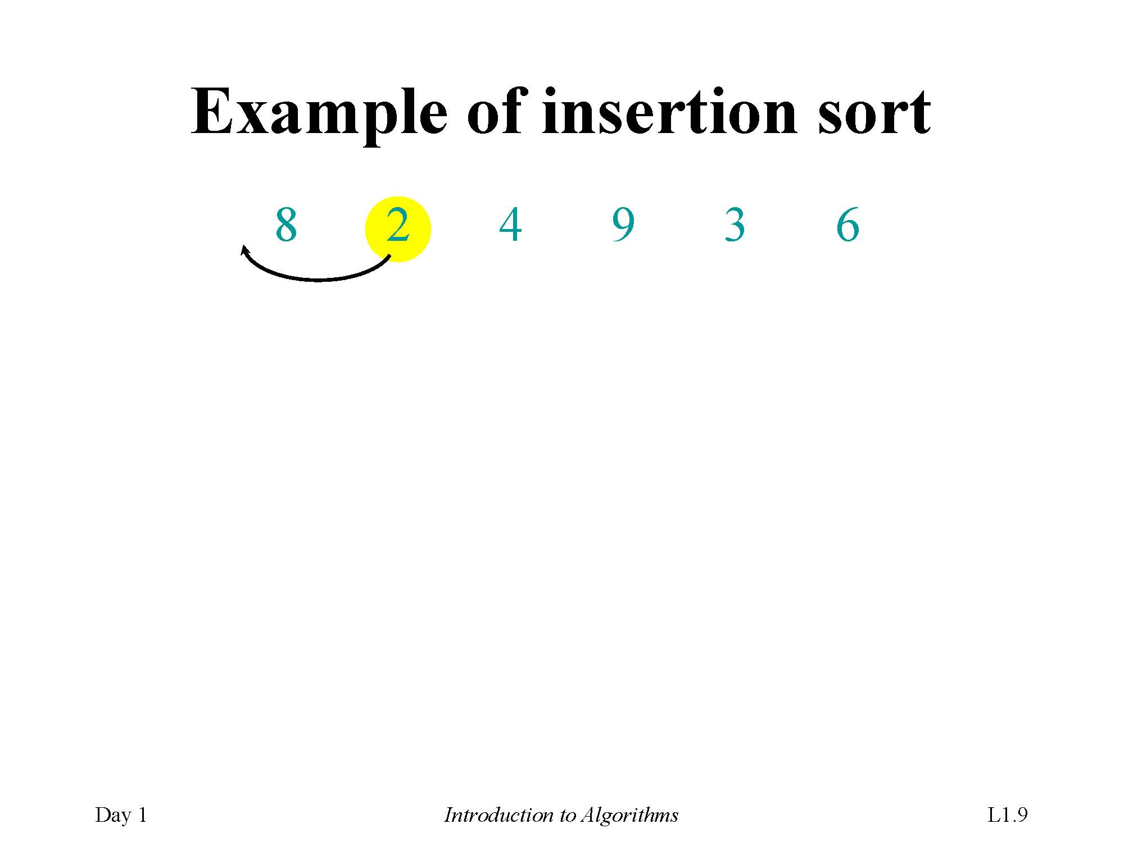
Example of insertion sort

Slide 18
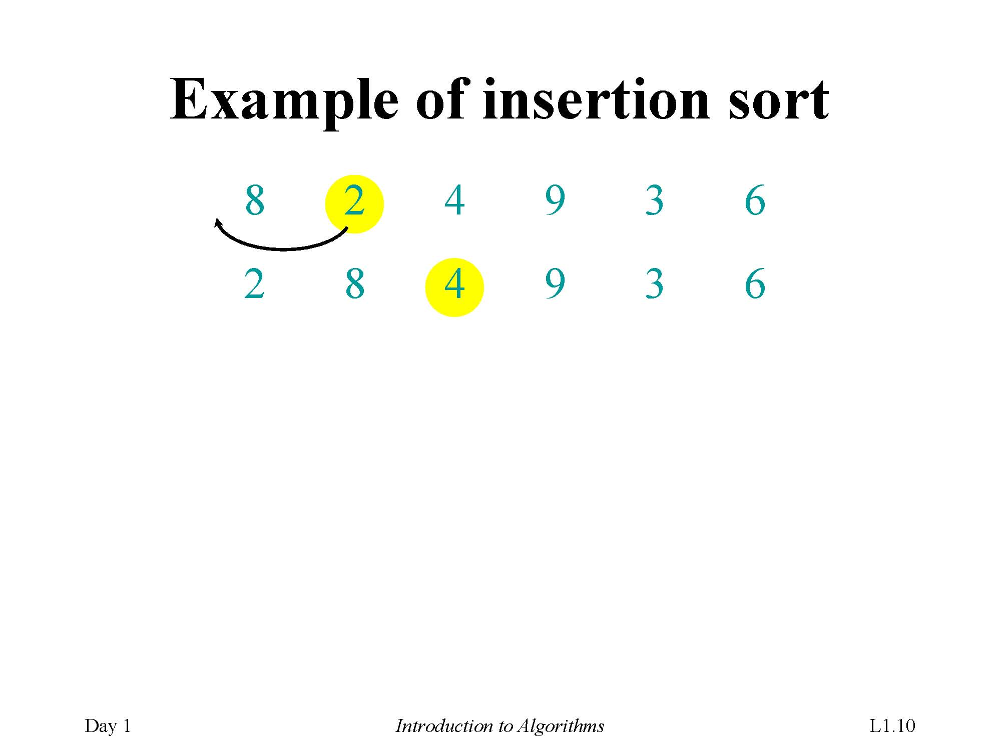
Example of insertion sort

Slide 19
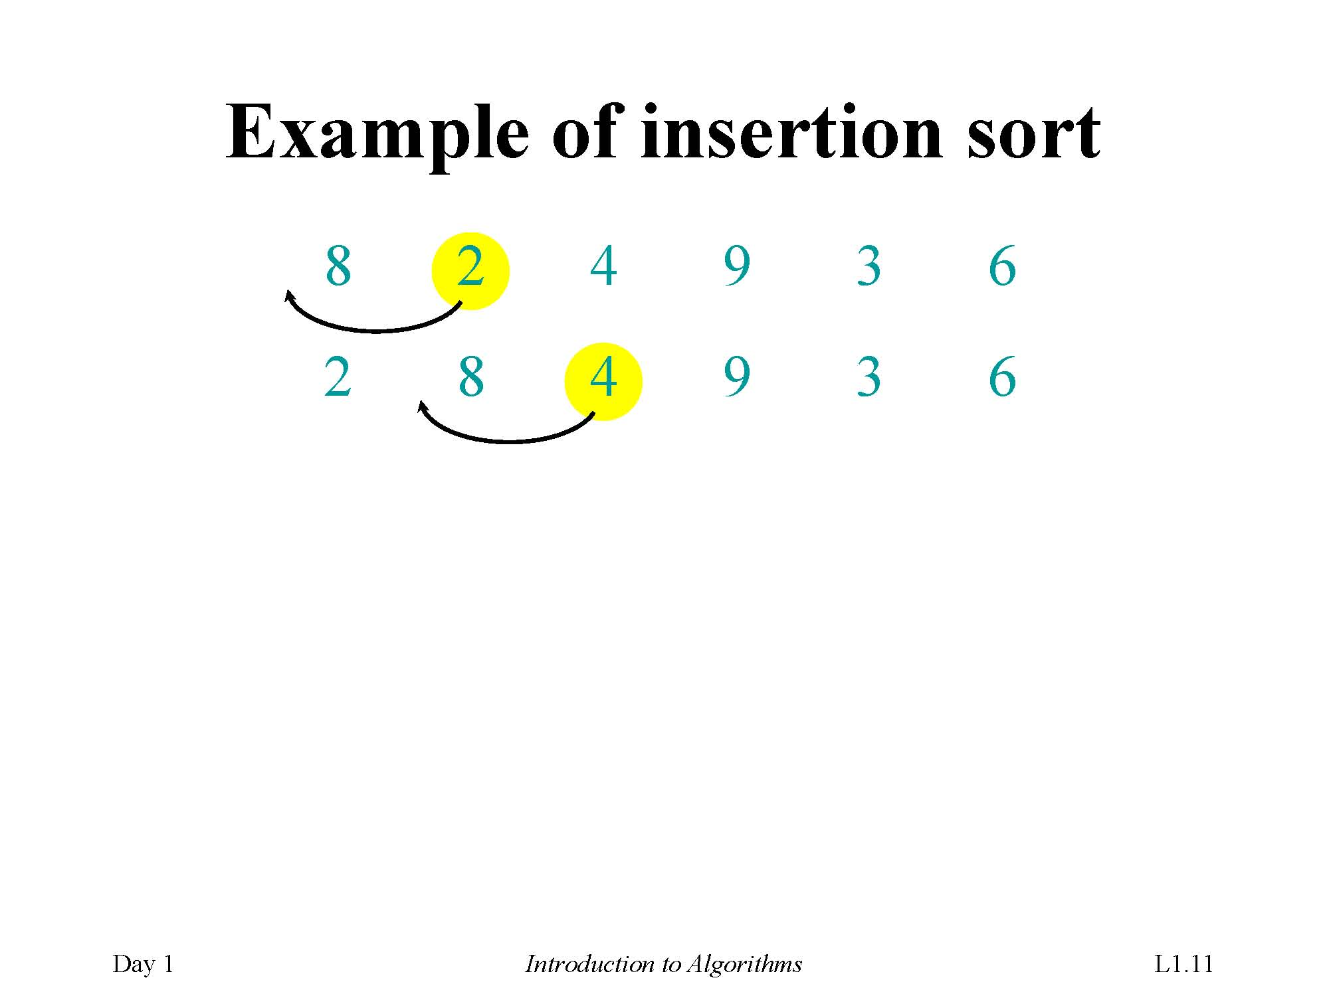
Example of insertion sort

Slide 20
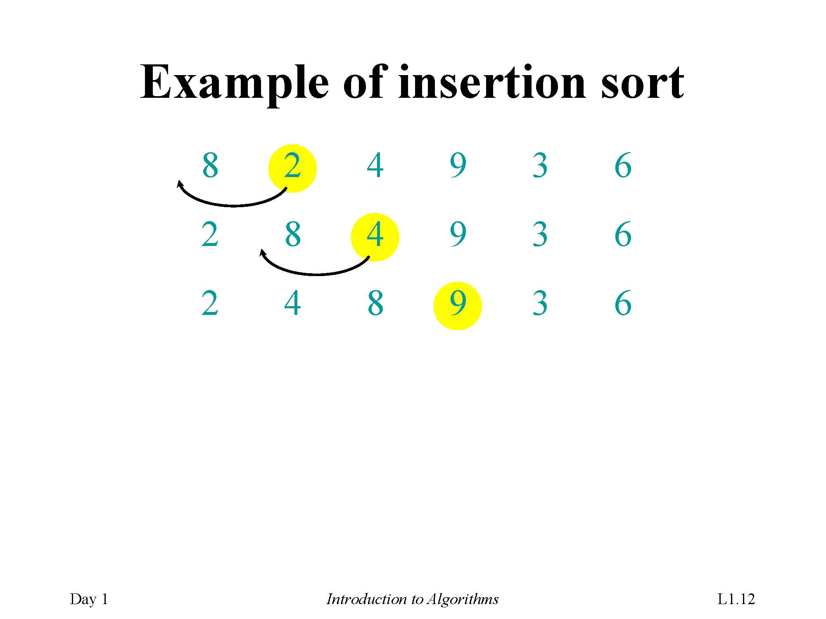
Example of insertion sort

Slide 21
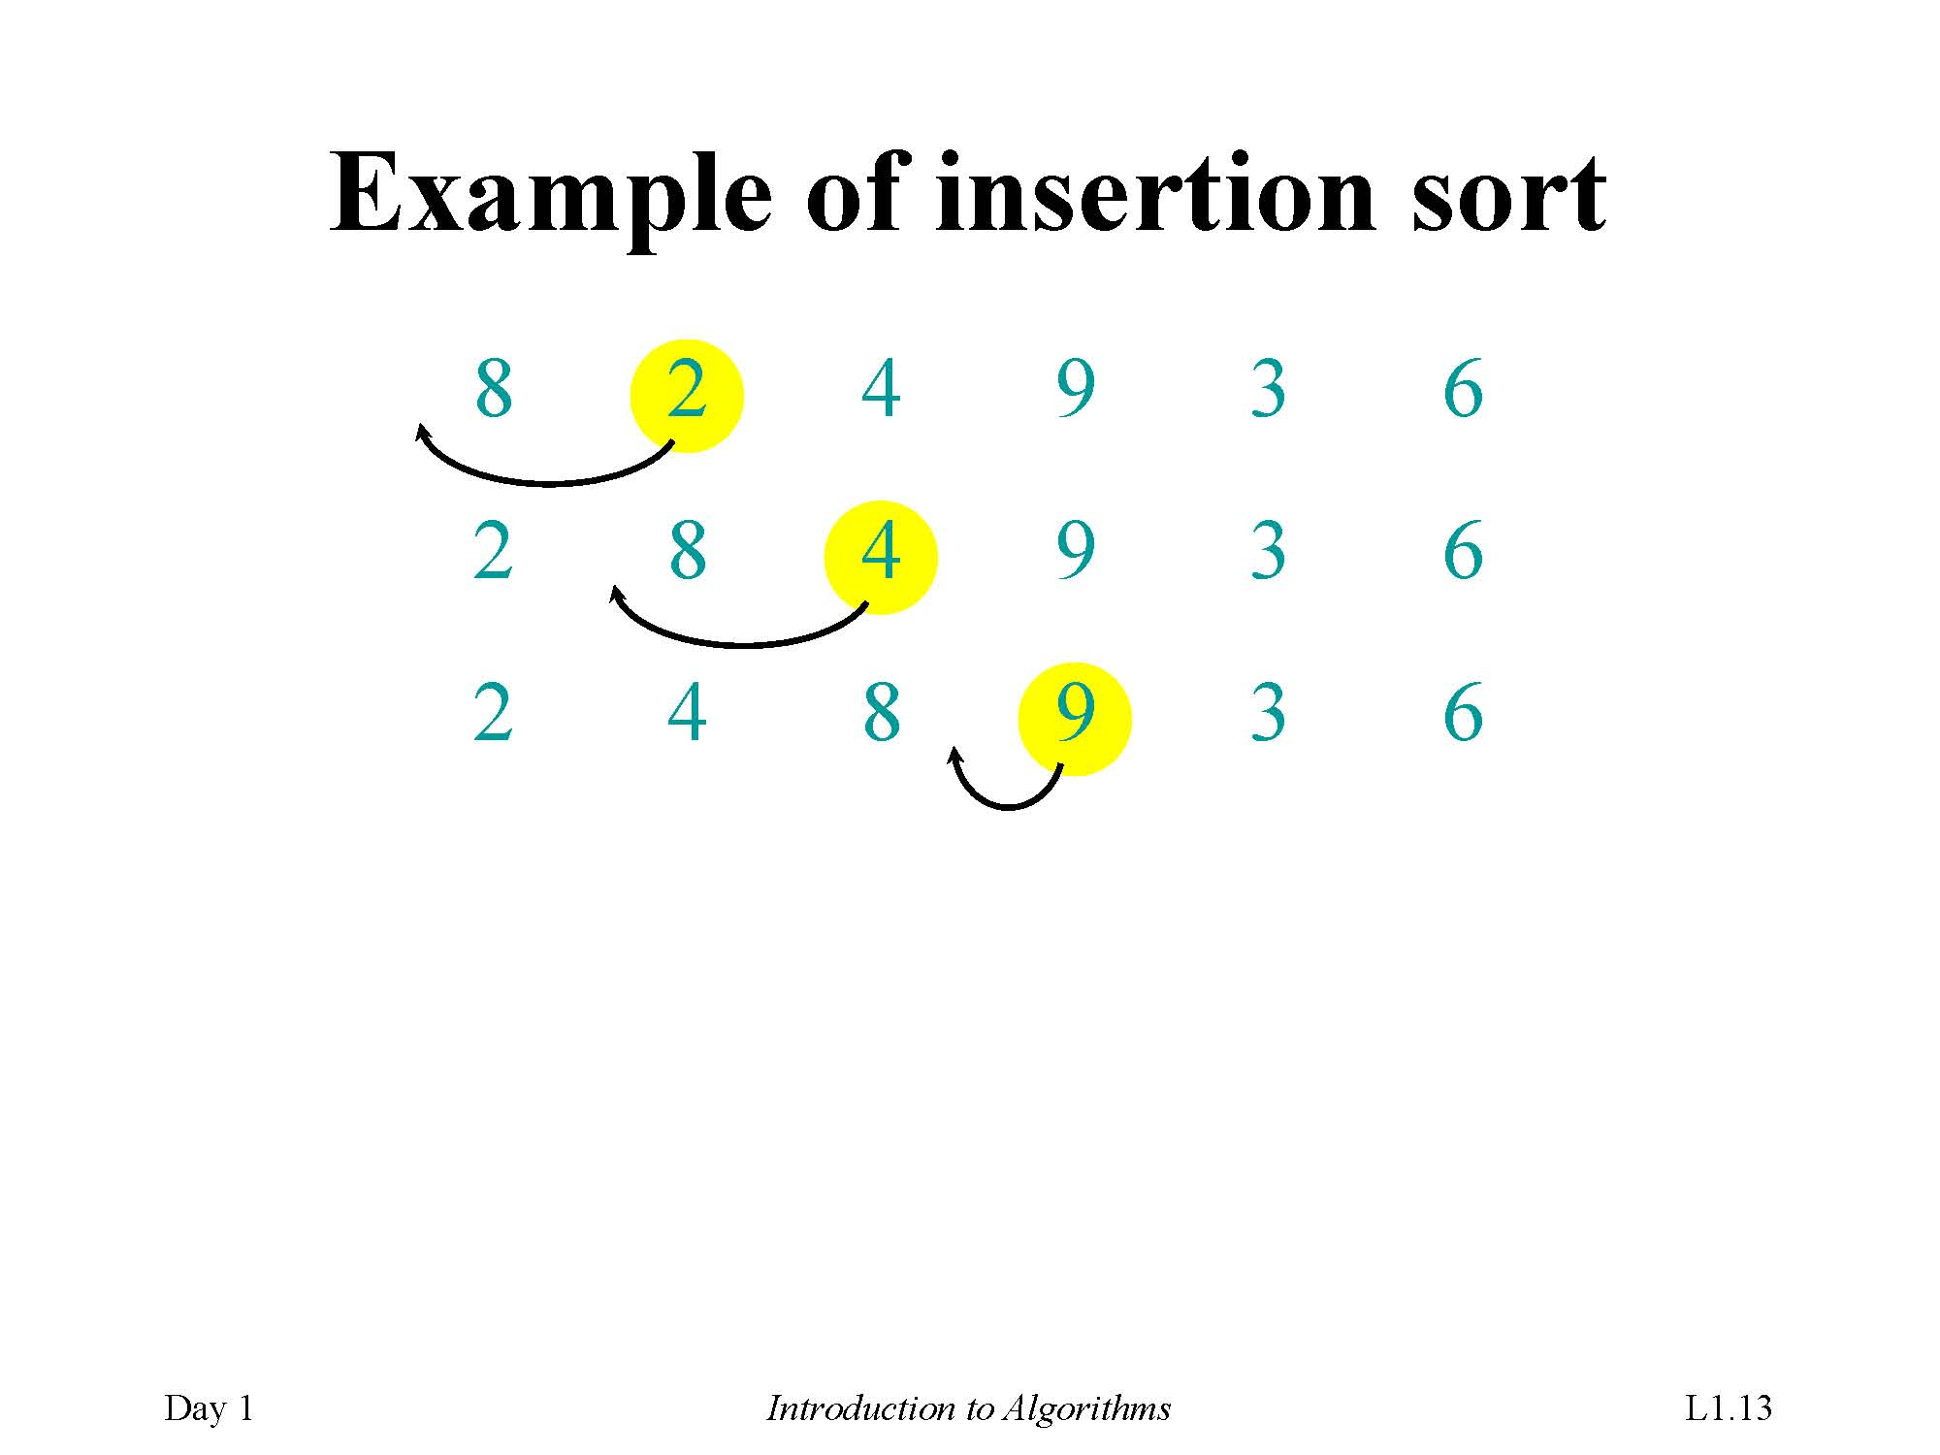
Example of insertion sort

Slide 22
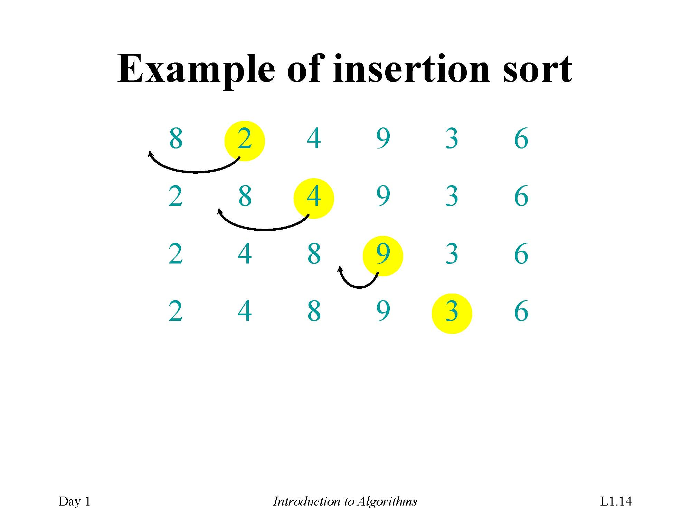
Example of insertion sort

Slide 23
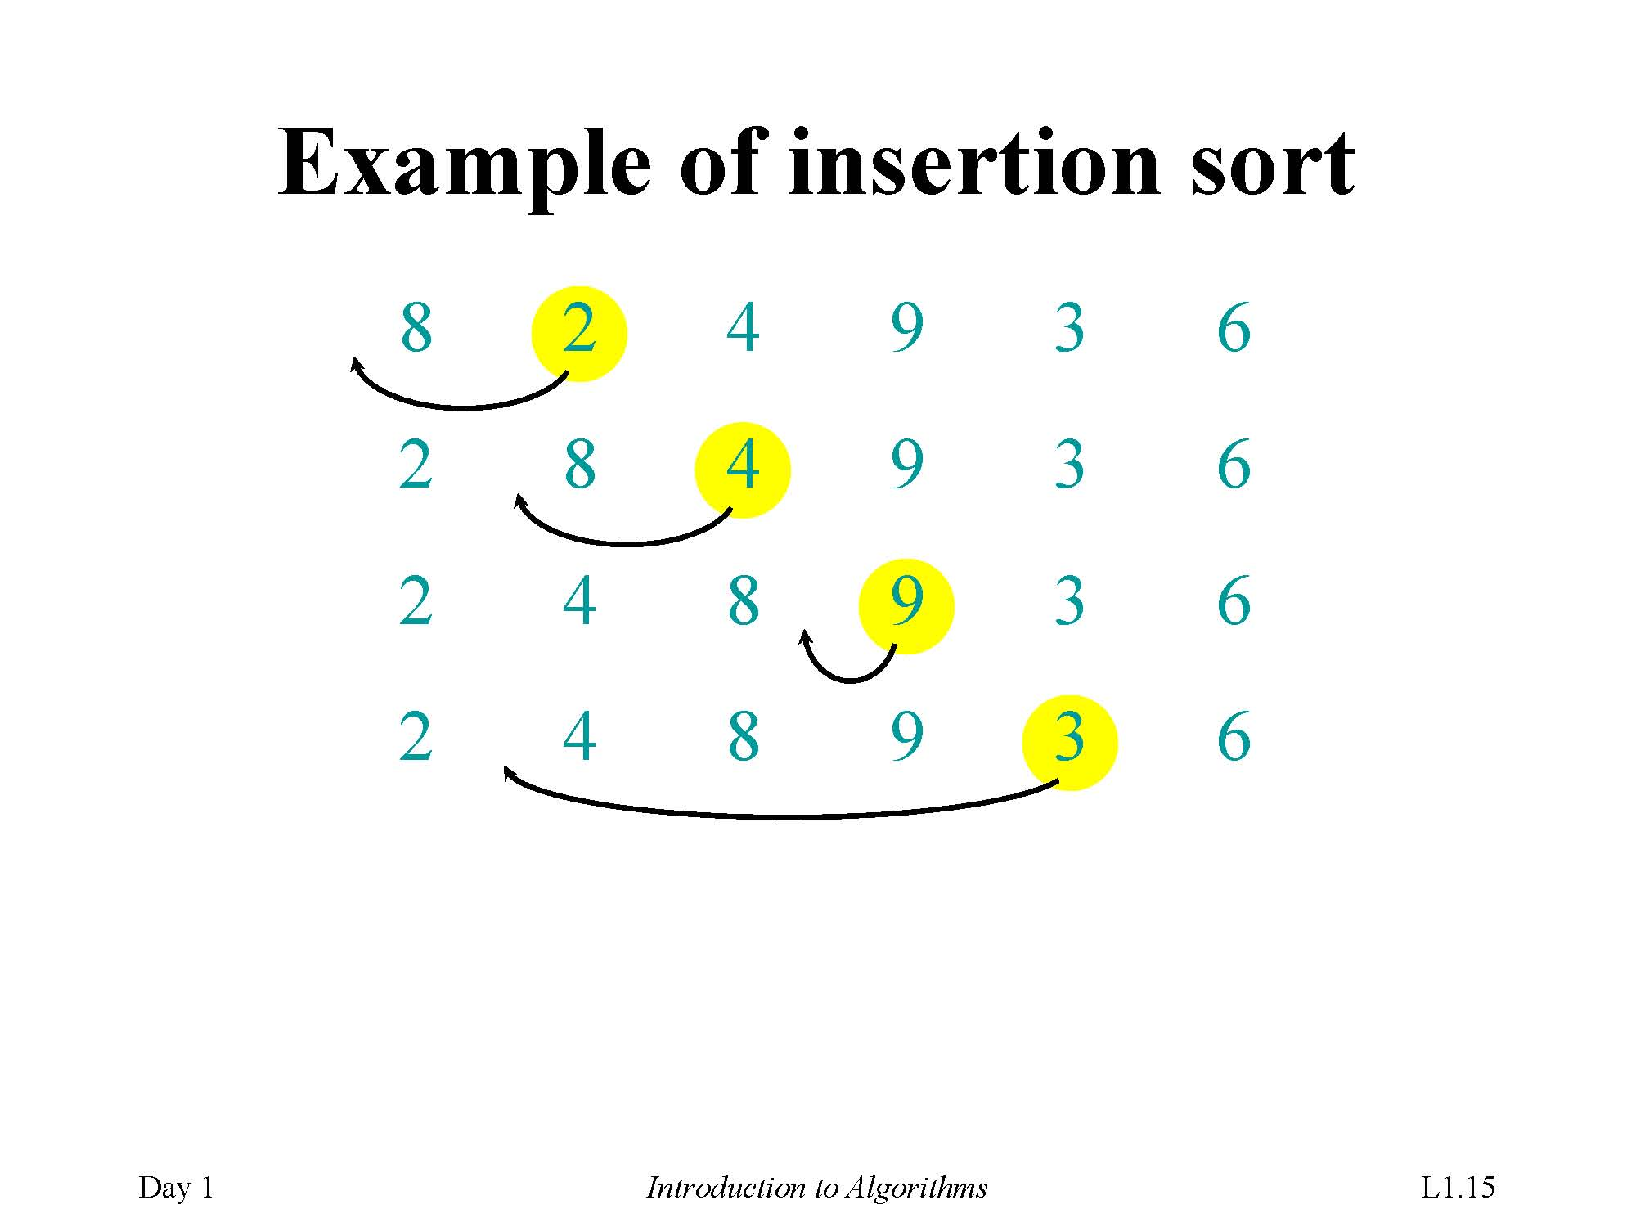
Example of insertion sort

Slide 24
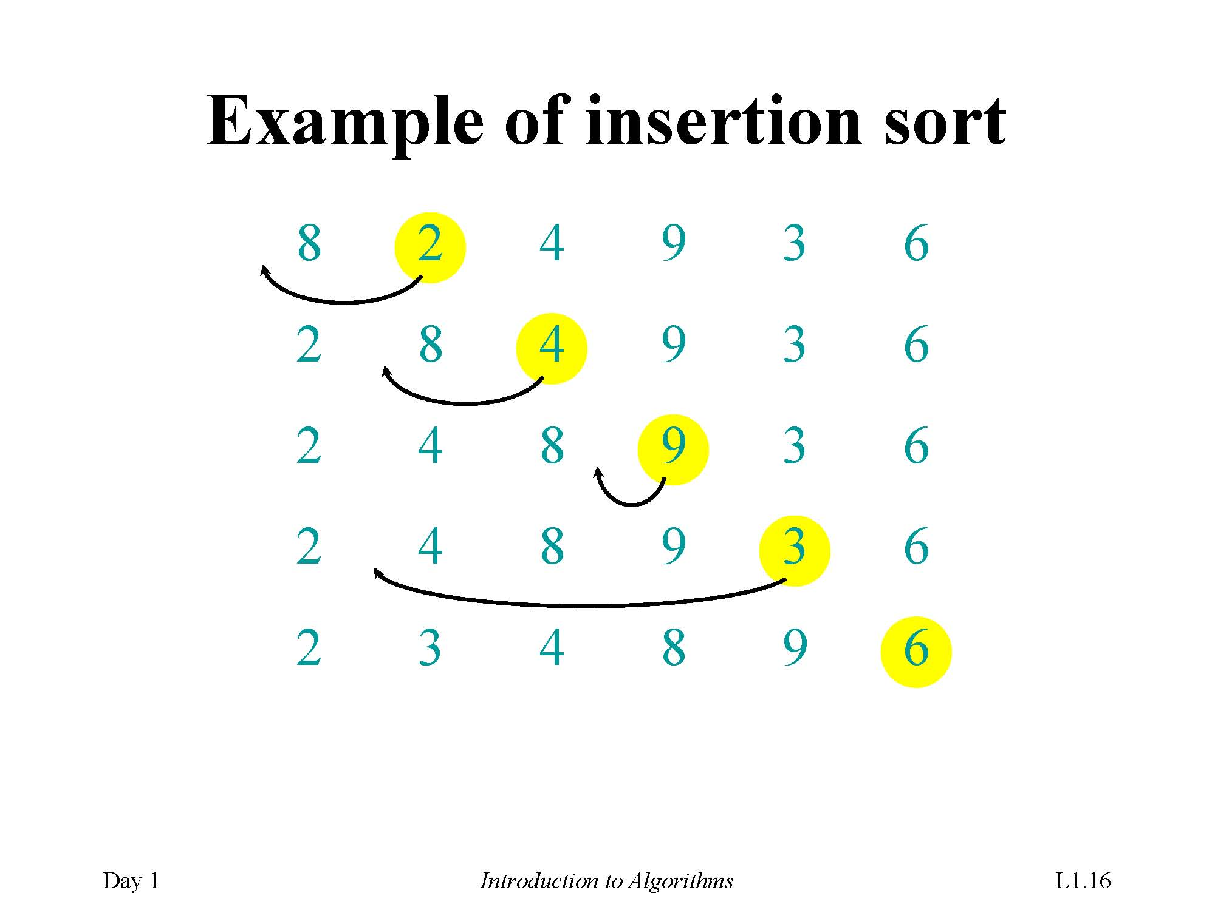
Example of insertion sort

Slide 25
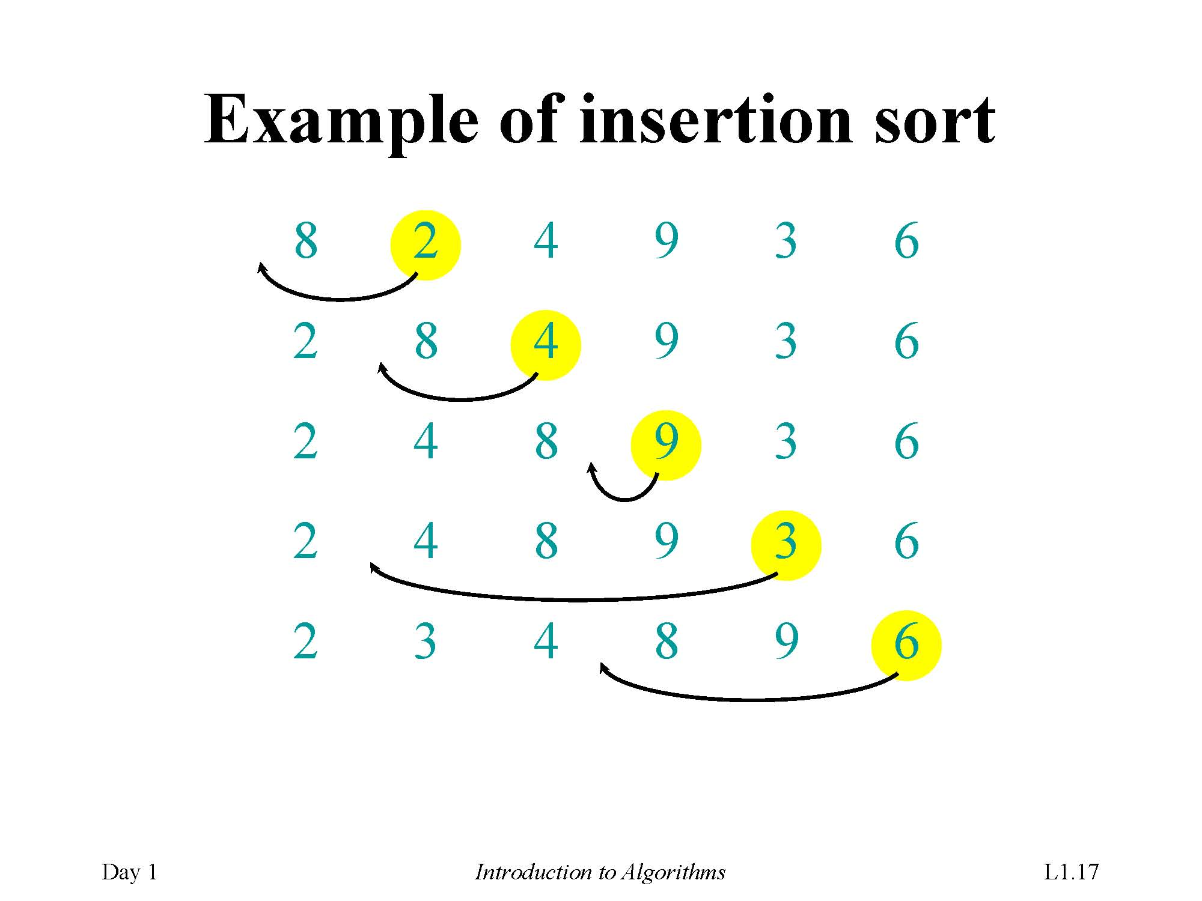
Example of insertion sort

Slide 26
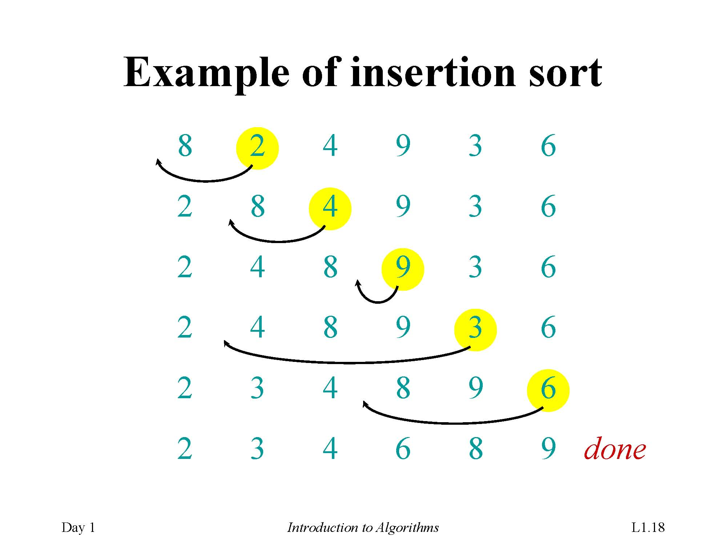
Example of insertion sort

Slide 27
2.2 Analyzing Algorithms
Run time: depend on the follow factors
Input: What kind of input?
Size of input: How many datum?
Machine: CPU How fast is the machine?
Computing model: RAM (random-access machine): How many machines?
In the RAM model, instructions are executed one after another, with no concurrent operations.
Operations| instructions contained in RAM model
Guarantee : Generally, we seek upper bounds on the running time, because everybody likes a guarantee
What is worst case?

Slide 28
Operations for RAM Model
Operations for RAM model
Arithmetic: add, subtract, multiply, divide, remainder, floor, ceiling
Logic: and, or, large, less, equal, not equal
data movement and control: load, store, copy; conditional and unconditional branch, subroutine call and return
Basic operations: all above

Slide 29
Computing run time
Run time formulation:
Input: What kind of input? I
Size of input: How many datum? n=|I|
Machine: CPU How fast is the machine? v1,…,vk
Computing model: RAM (random-access machine): How many machines? One only
Guarantee : Generally, we seek upper bounds on the running time, because everybody likes a guarantee max
Run time decided by: number of basic operations done and cpu speed
Run time: t = sum{n1/v1+…+nk/vk}

Slide 30
Time Complexity
Run time: machine-independent run time
t = sum{n1/v1+…+nk/vk}
t = sum{n1+…+nk}/v Suppose that vi=v (invariant)
t =c⋅sum{n1+…+nk}
t ∼ sum{n1+…+nk} machine-independent
Ignore machine-dependent constants
Time Complexity: simplified run time
T= sum{n1+…+nk} total number of basic operations
Notations:
T(n,I) | T_{A}(n,I) ← T(A;n,I) ← T= sum{n1+…+nk}

Slide 31
Time Complexity: Further Simplified
T(n,I): may differ from I (Any input of size n)
Further simplified time complexity: Three cases below
Worst-case: (usually)
T(n) = maximum time of algorithm on any input of size n.
T(n)=max_{I} {T(n,I)}
Time Complexity (Default )
Average-case: (sometimes)
T(n) = expected time of algorithm over all inputs of size n.
Need assumption of statistical distribution of inputs.
?
Best-case: (bogus)
Cheat with a slow algorithm that works fast on some input.
?

Slide 32
Θ-notation
Asymptotic Analysis:
Asymptotic analysis: Look at growth of T(n) as n →∞.
Math:
Θ(g(n)) = { f (n): there exist positive constants c₁, c₂, and n₀ such that
0 ≤c₁ g(n) ≤ f (n) ≤ c₂ g(n) for all n ≥ n₀}
Engineering:
Drop low-order terms; ignore leading constants.
Example: 3n³ + 90n² –5n + 6046 = Θ(n³)

Slide 33
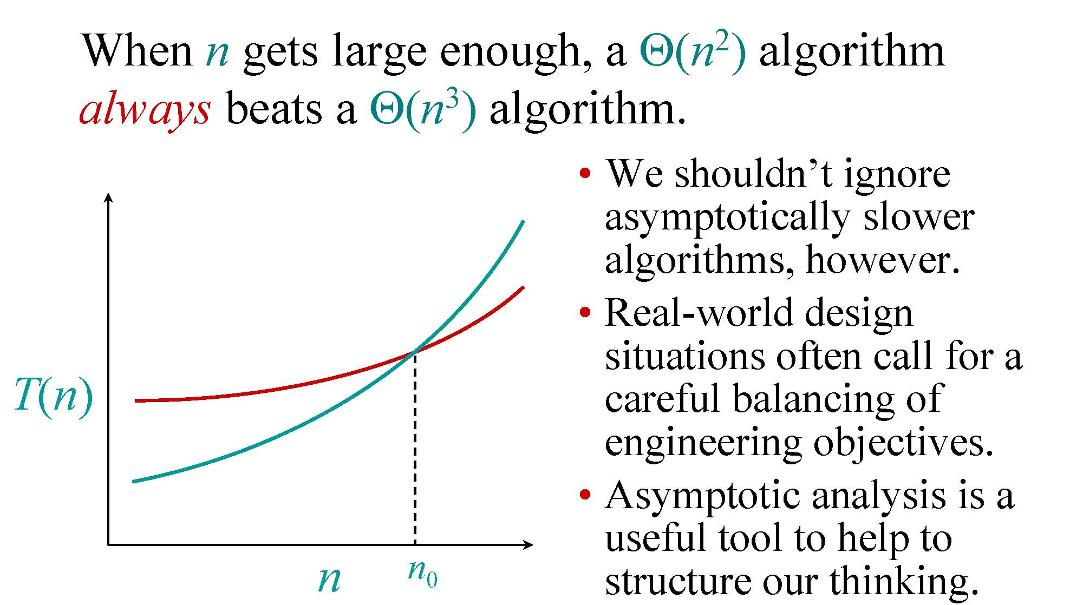
Asymptotic performance
When n gets large enough, a Θ(n2) algorithm always beats a Θ(n3) algorithm.
We shouldn’t ignoreasymptotically sloweralgorithms, however.
Real-world designsituations often call for a careful balancing ofengineering objectives.
Asymptotic analysis is a useful tool to help to nn0 structure our thinking.

Slide 34
Analyzing algorithm: Insertion Sort
Worst case: Input reverse sorted.
T(n)= sum {j-1, j=2..n} = n(n-1)/2 = Θ(n²)
T(n)= 1+sum{[1+1+2+2(j-1)+1], j=2..n} = 1+n(n-1)+3(n-1)=n²+2n-2 = Θ(n²)
Accurate?
T(n)= sum_{j=2..n}{Θ(j)} = Θ(n²)
How to calculate T(n)?
Average-case & Best-case
?

Slide 35
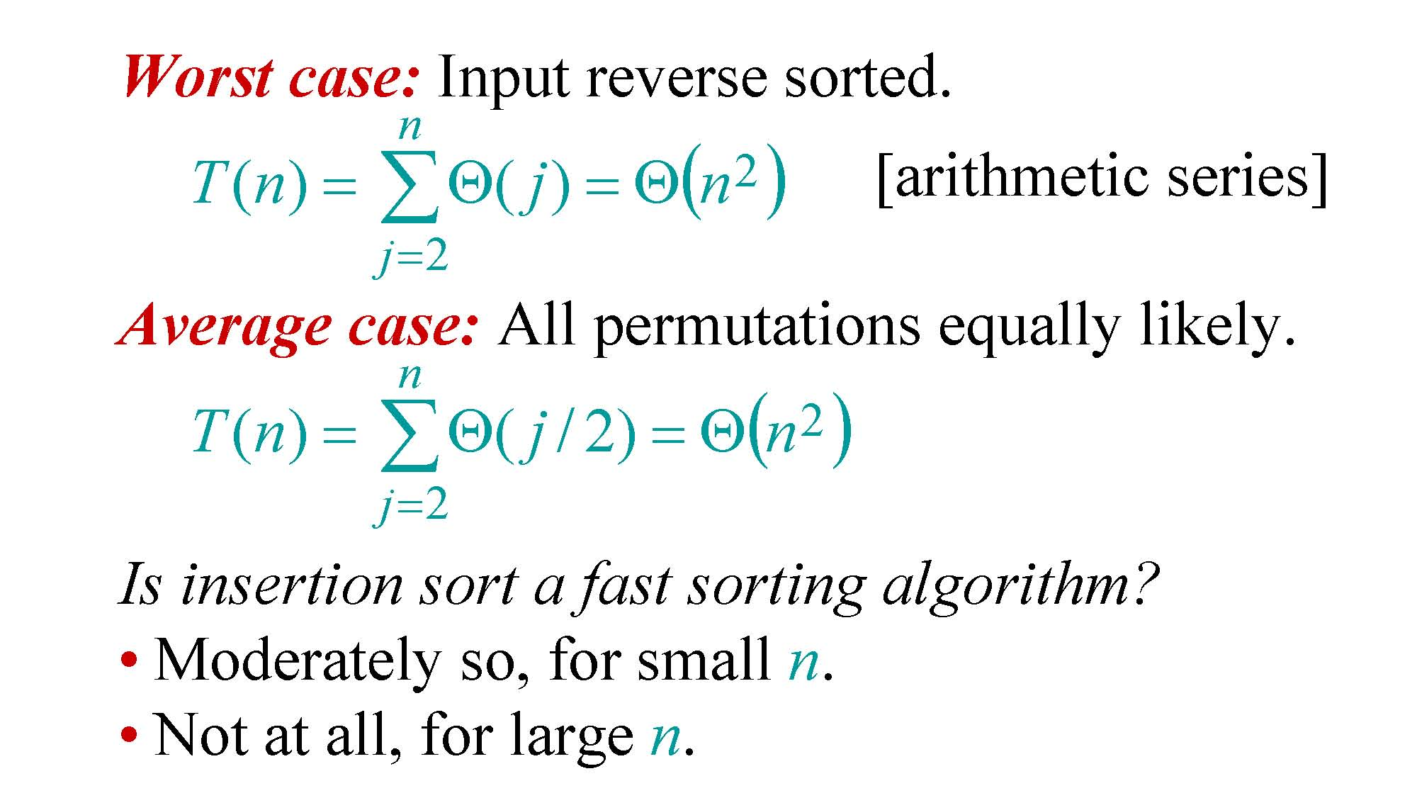
Insertion sort analysis
Worst case: Input reverse sorted.
n
2
() [arithmetic series]
T (n) =∑Θ( j) =Θn j=2
Average case: All permutations equally likely.
n
2
T (n) =∑Θ( j / 2) =Θ(n ) j=2
Is insertion sort a fast sorting algorithm?
Moderately so, for small n.
Not at all, for large n.

Slide 36
2.3 Designing Algorithms
Designing Algorithms: How?
Divide-and-Conquer Approach
Merge Sort
Time complexity for Divide-and-Conquer

Slide 37
Divide-and-Conquer Approach
Divide-and-conquer paradigm
Divide the problem into a number of subproblems.
Conquer the subproblems by solving them recursively. If the subproblem sizes are small enough, however, just solve the subproblems in a straightforward manner.
Combine the solutions to the subproblems into the solution for the original problem.

Slide 38
Merge Sort Algorithm: DC
Problem:
Input: A[1,n]
Output: A[1,n] in sorted order
Divide-and-conquer paradigm
Divide: Divide the n-element sequence to be sorted into two subsequences of n/2 elements each.
Conquer: Sort the two subsequences recursively using merge sort.
Combine: Merge the two sorted subsequences to produce the sorted answer.

Slide 39
Merge Sort Algorithm: Pseudocode
MERGE-SORT A[1 . . n]
1. If n = 1, done.
2. Recursively sort A[ 1 . . ⎡n/2⎤ ]
and A[⎡n/2⎤+1 . . n ] .
3. “Merge” the 2 sorted lists.
… to be continued!
Key subroutine: MERGE

Slide 40
Merge Sort Algorithm: General Case
Problem:
Input: A[p,r]
Output: A[p,r] in sorted order
MERGE-SORT(A, p, r)
if p < r
then q ← ⌊(p + r)/2⌋
MERGE-SORT(A, p, q)
MERGE-SORT(A, q + 1, r)
MERGE(A, p, q, r)

Slide 41
Merge Two Sorted Lists
Problem:
Input: A[p,q] and A[q+1,r], p ≤ q< r, are in sorted order
Output: A[p,r] in sorted order
Procedure
See the Instance below

Slide 42
Merge Two Sorted Lists : Pseudocode

Slide 43
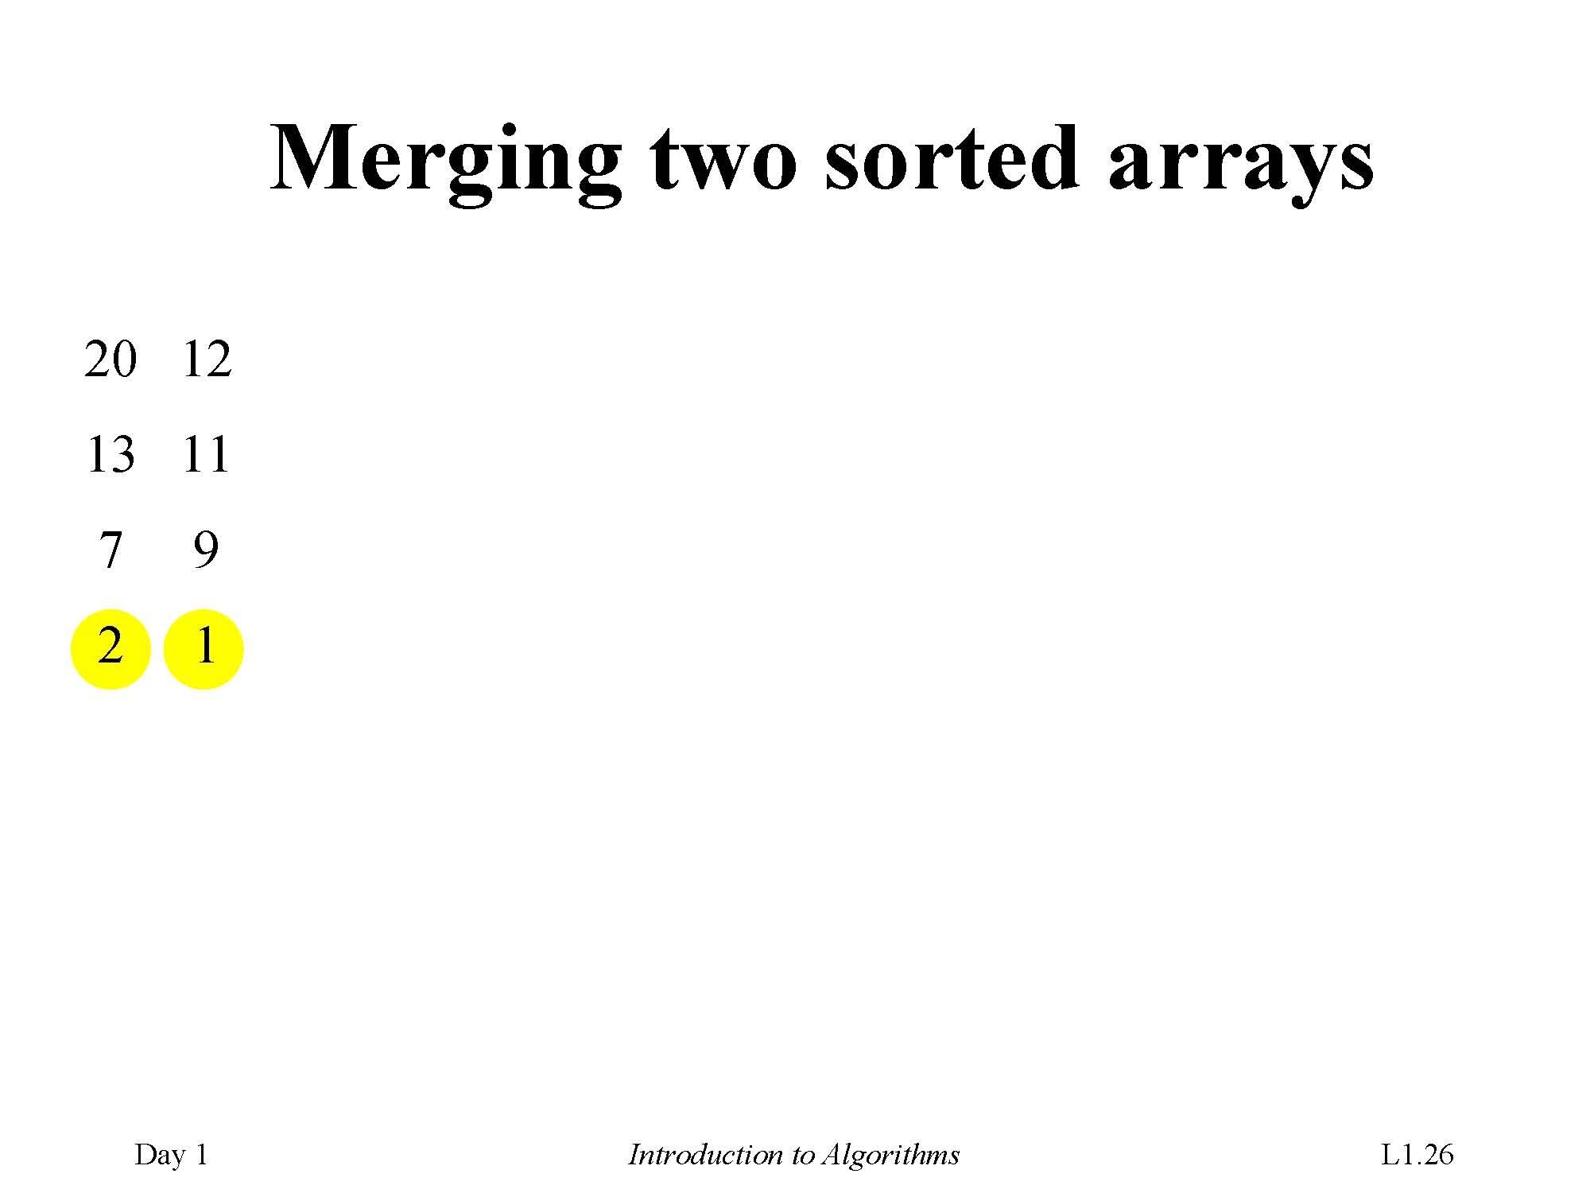
Merging two sorted arrays
2 7 13 20
1 9 11 12

Slide 44
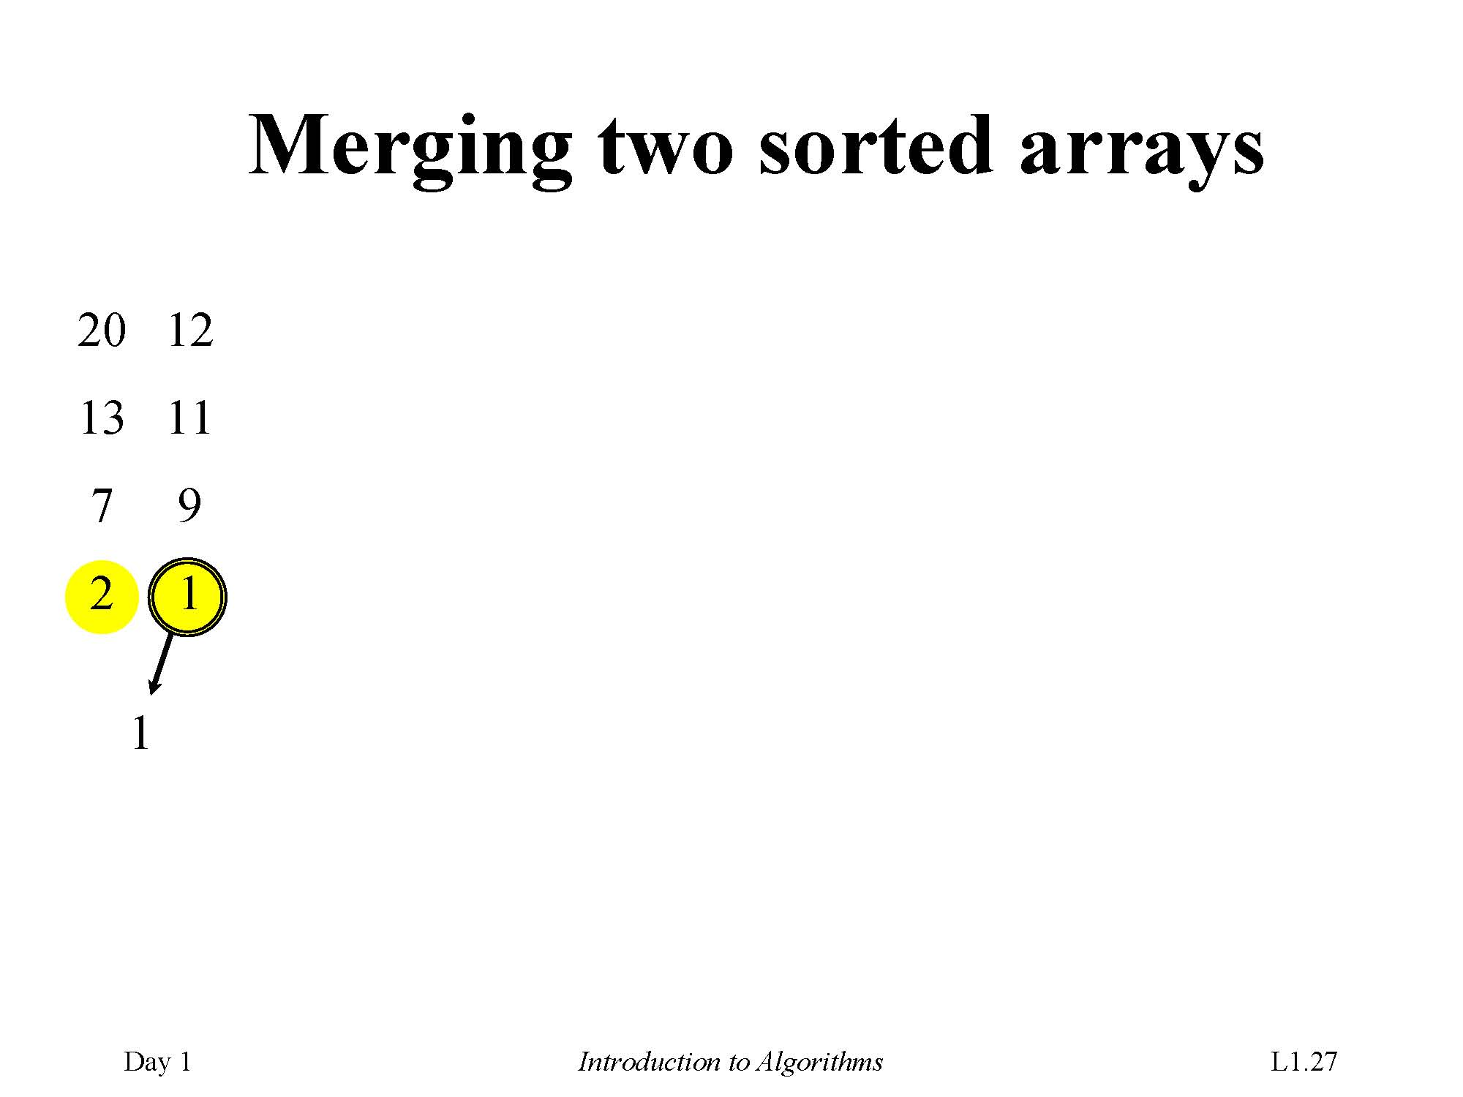

Slide 45
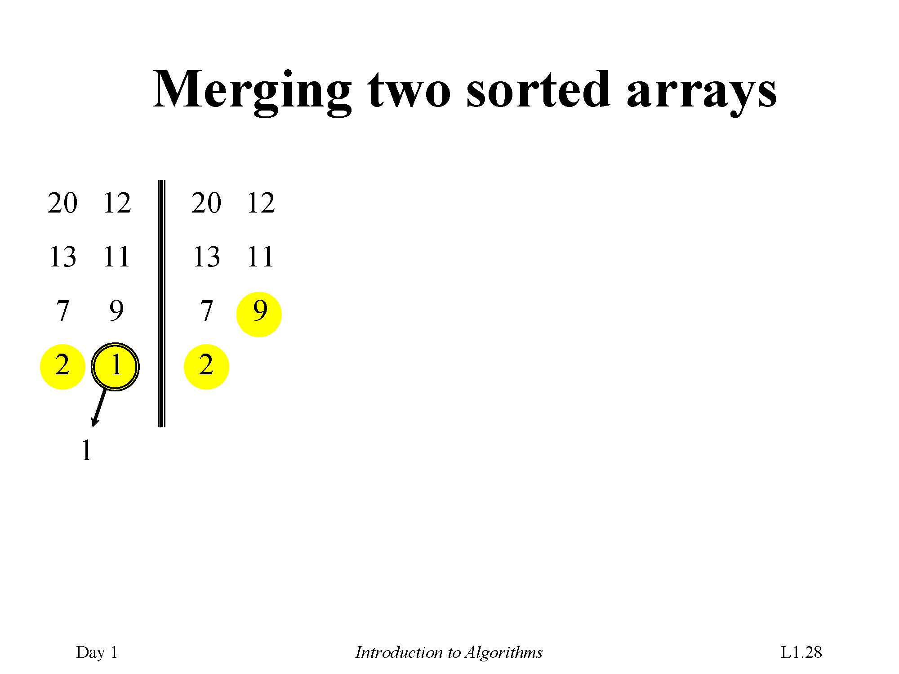

Slide 46
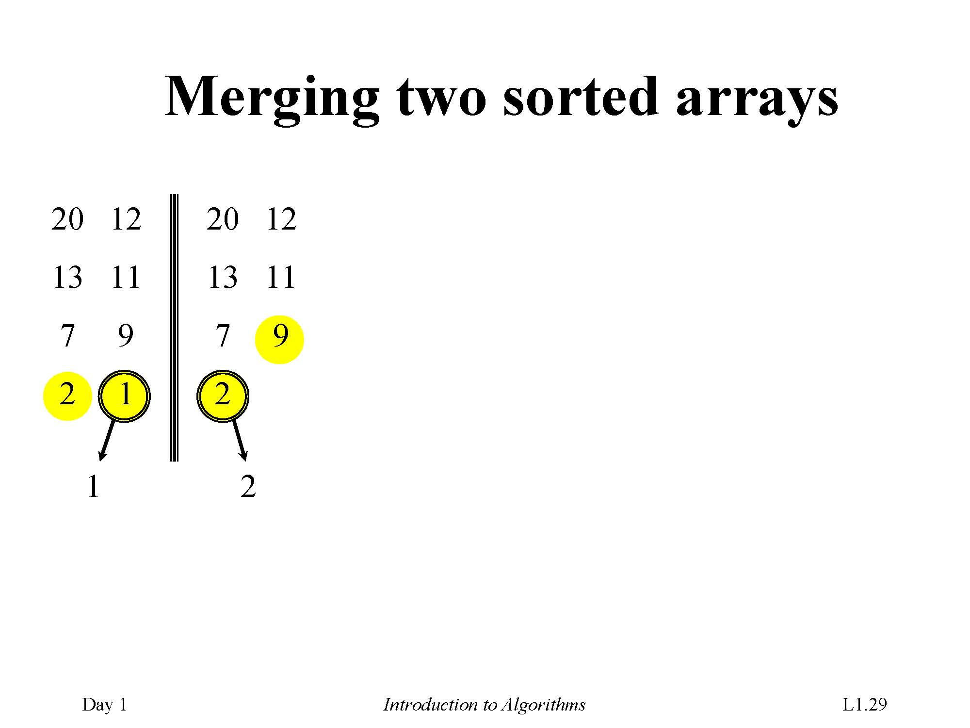

Slide 47
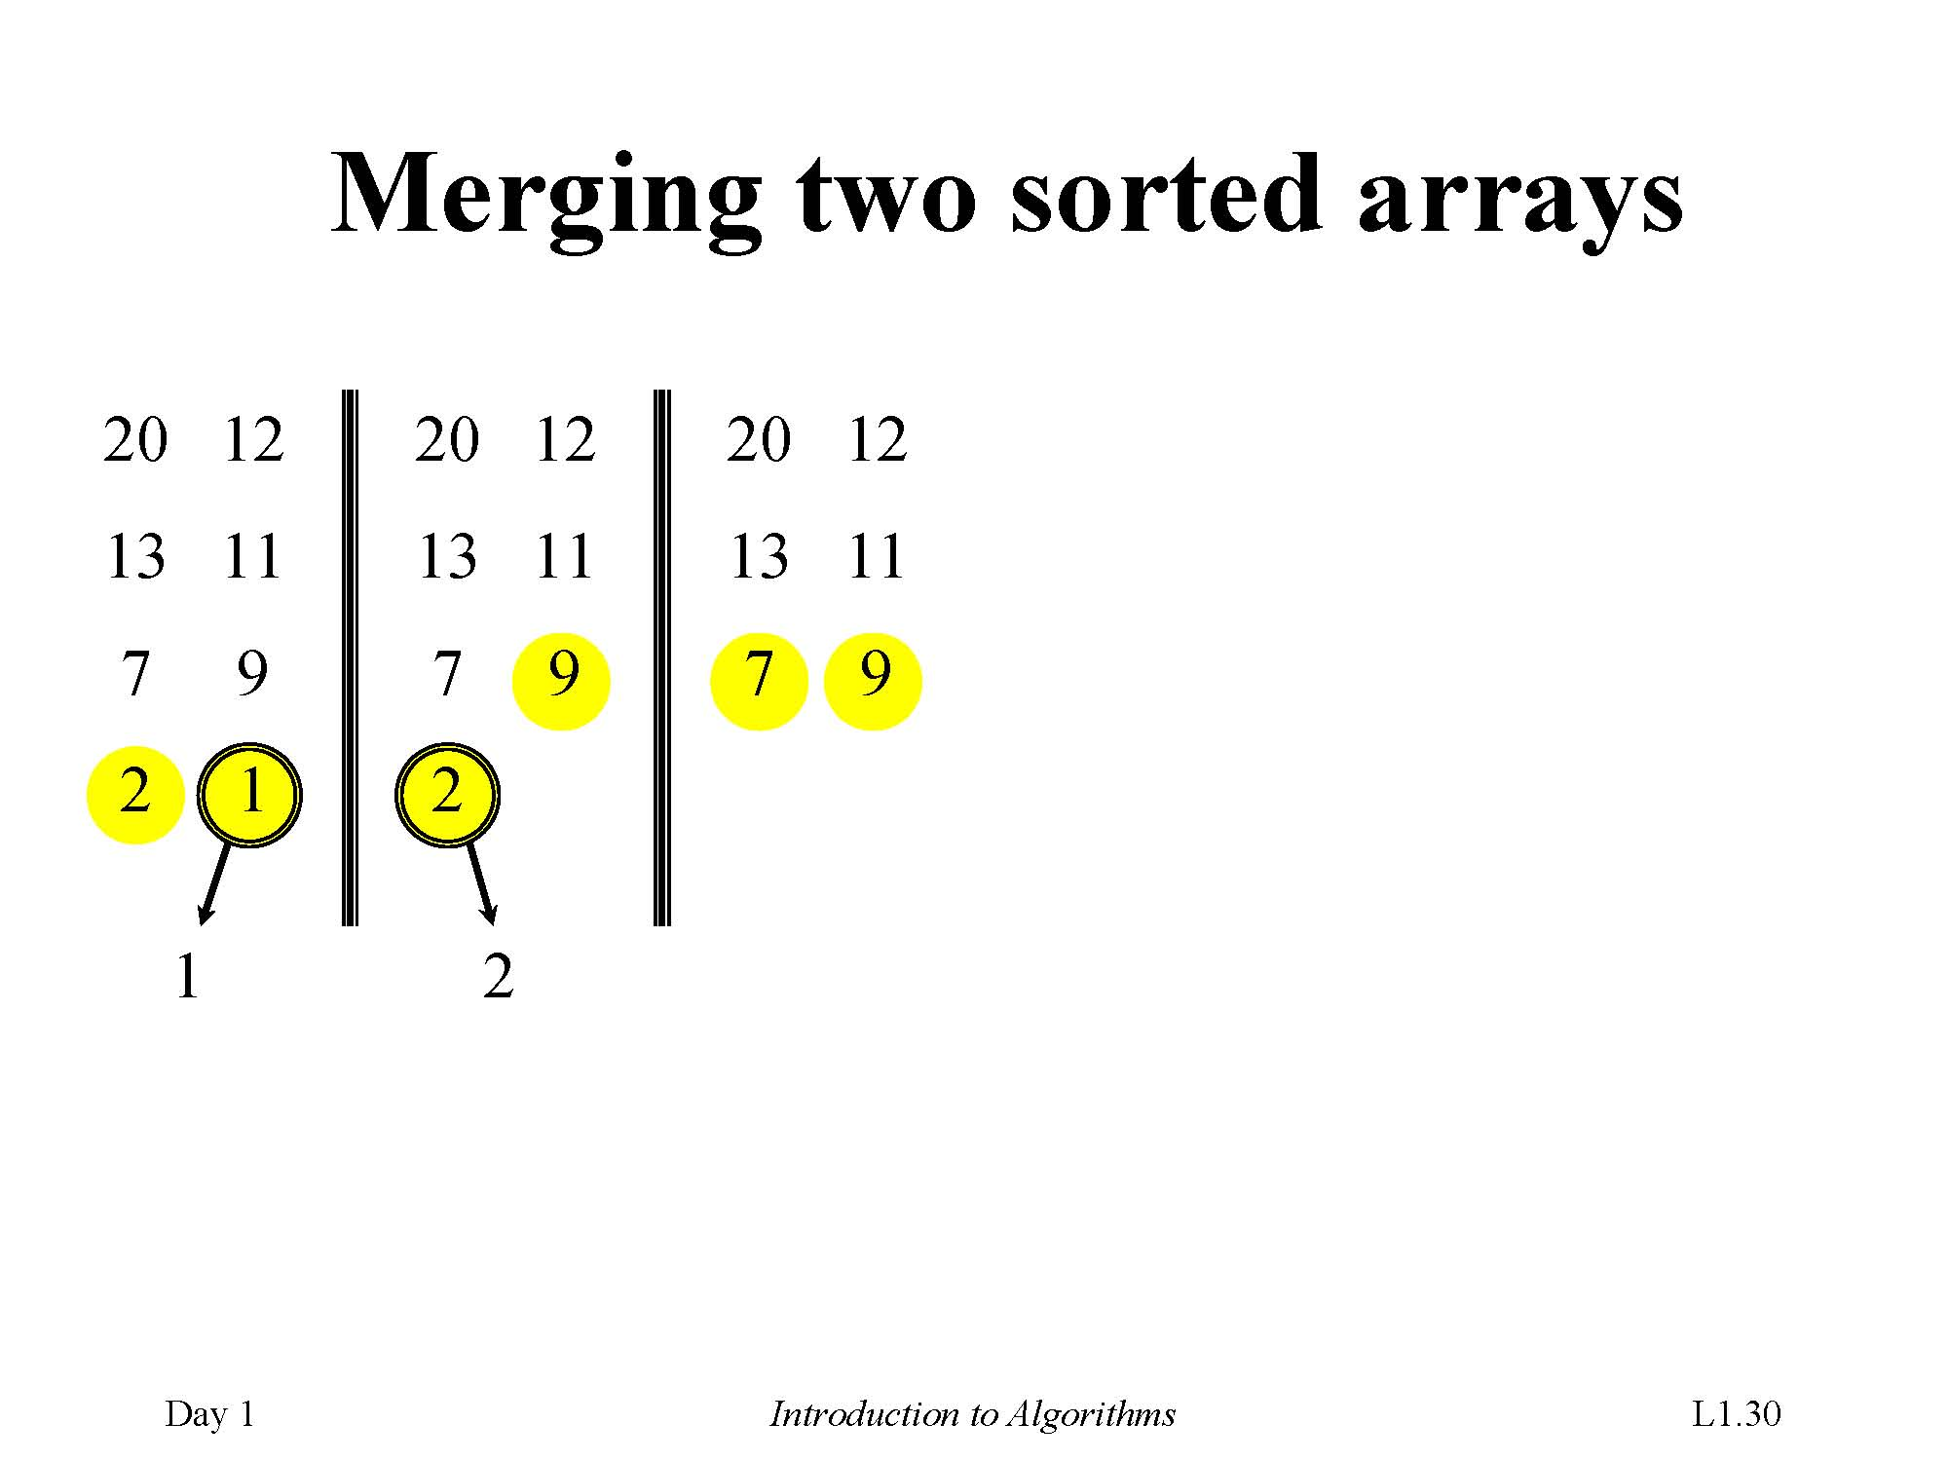

Slide 48
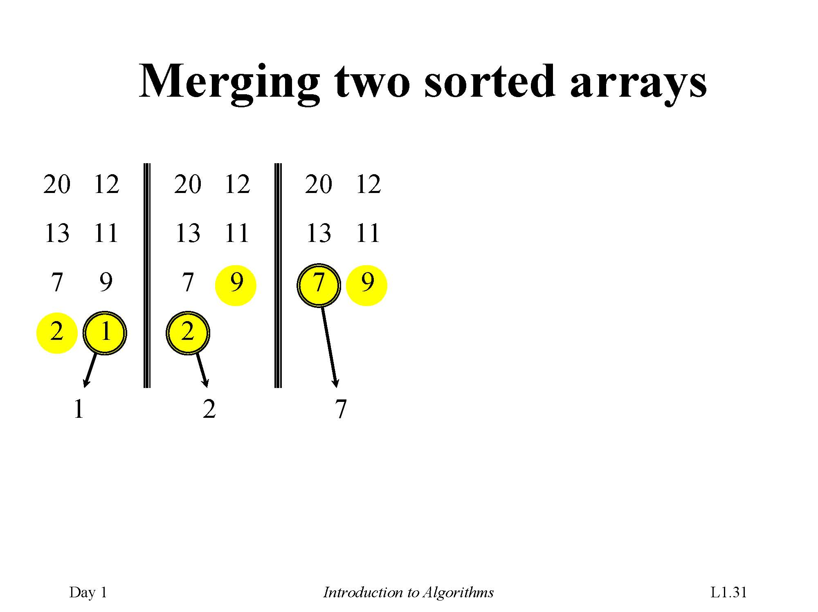

Slide 49
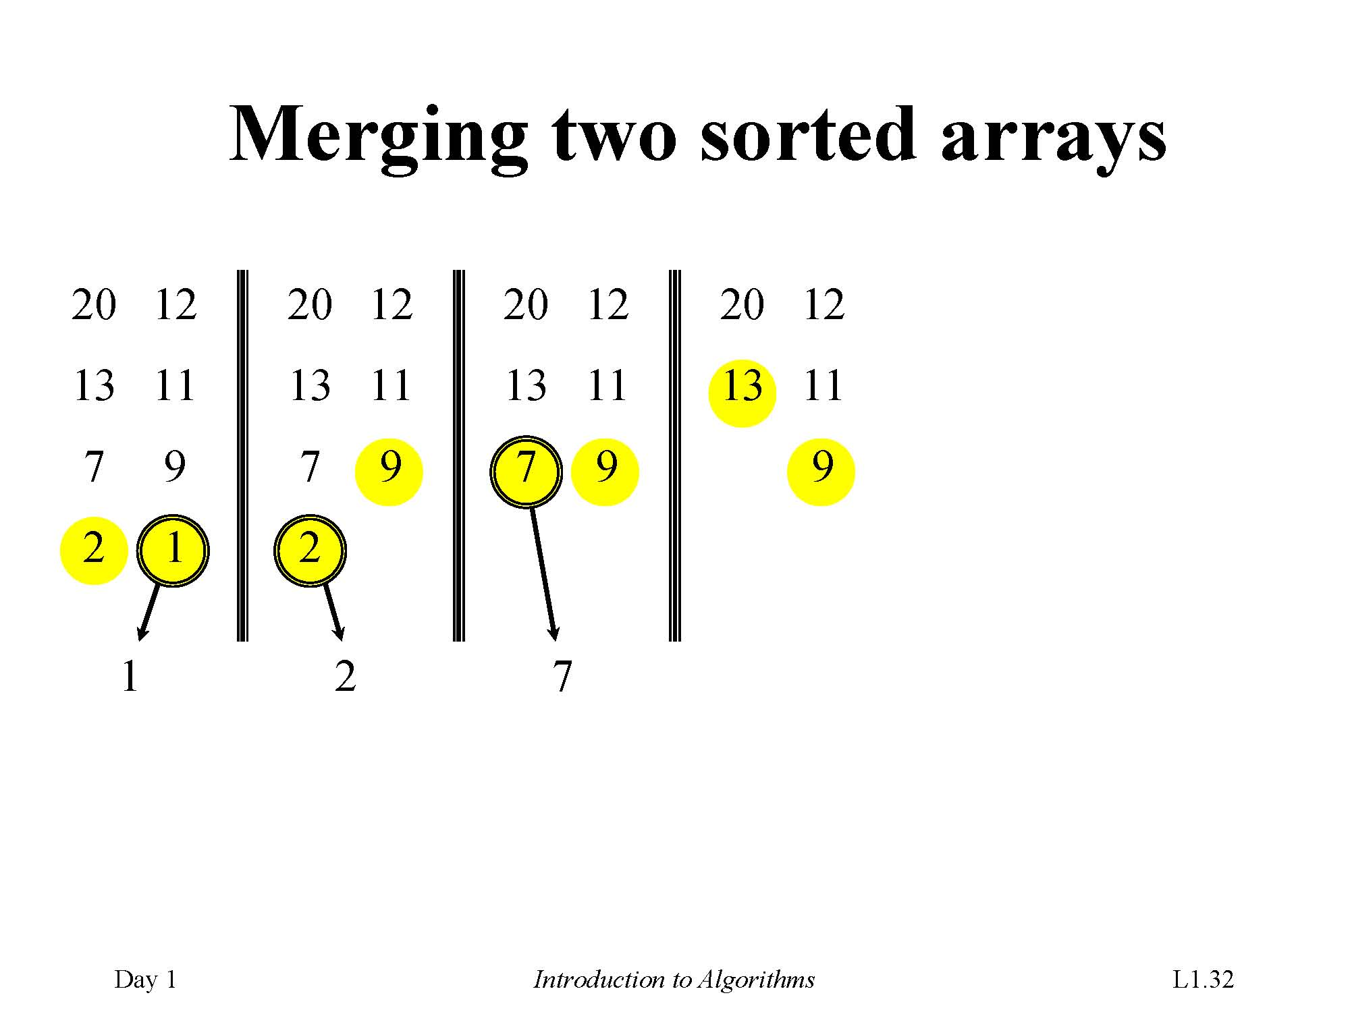

Slide 50
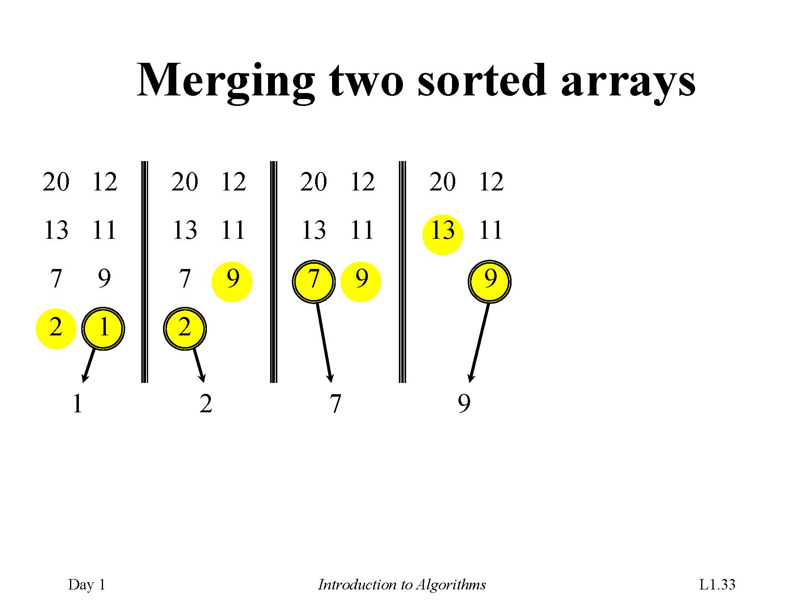

Slide 51
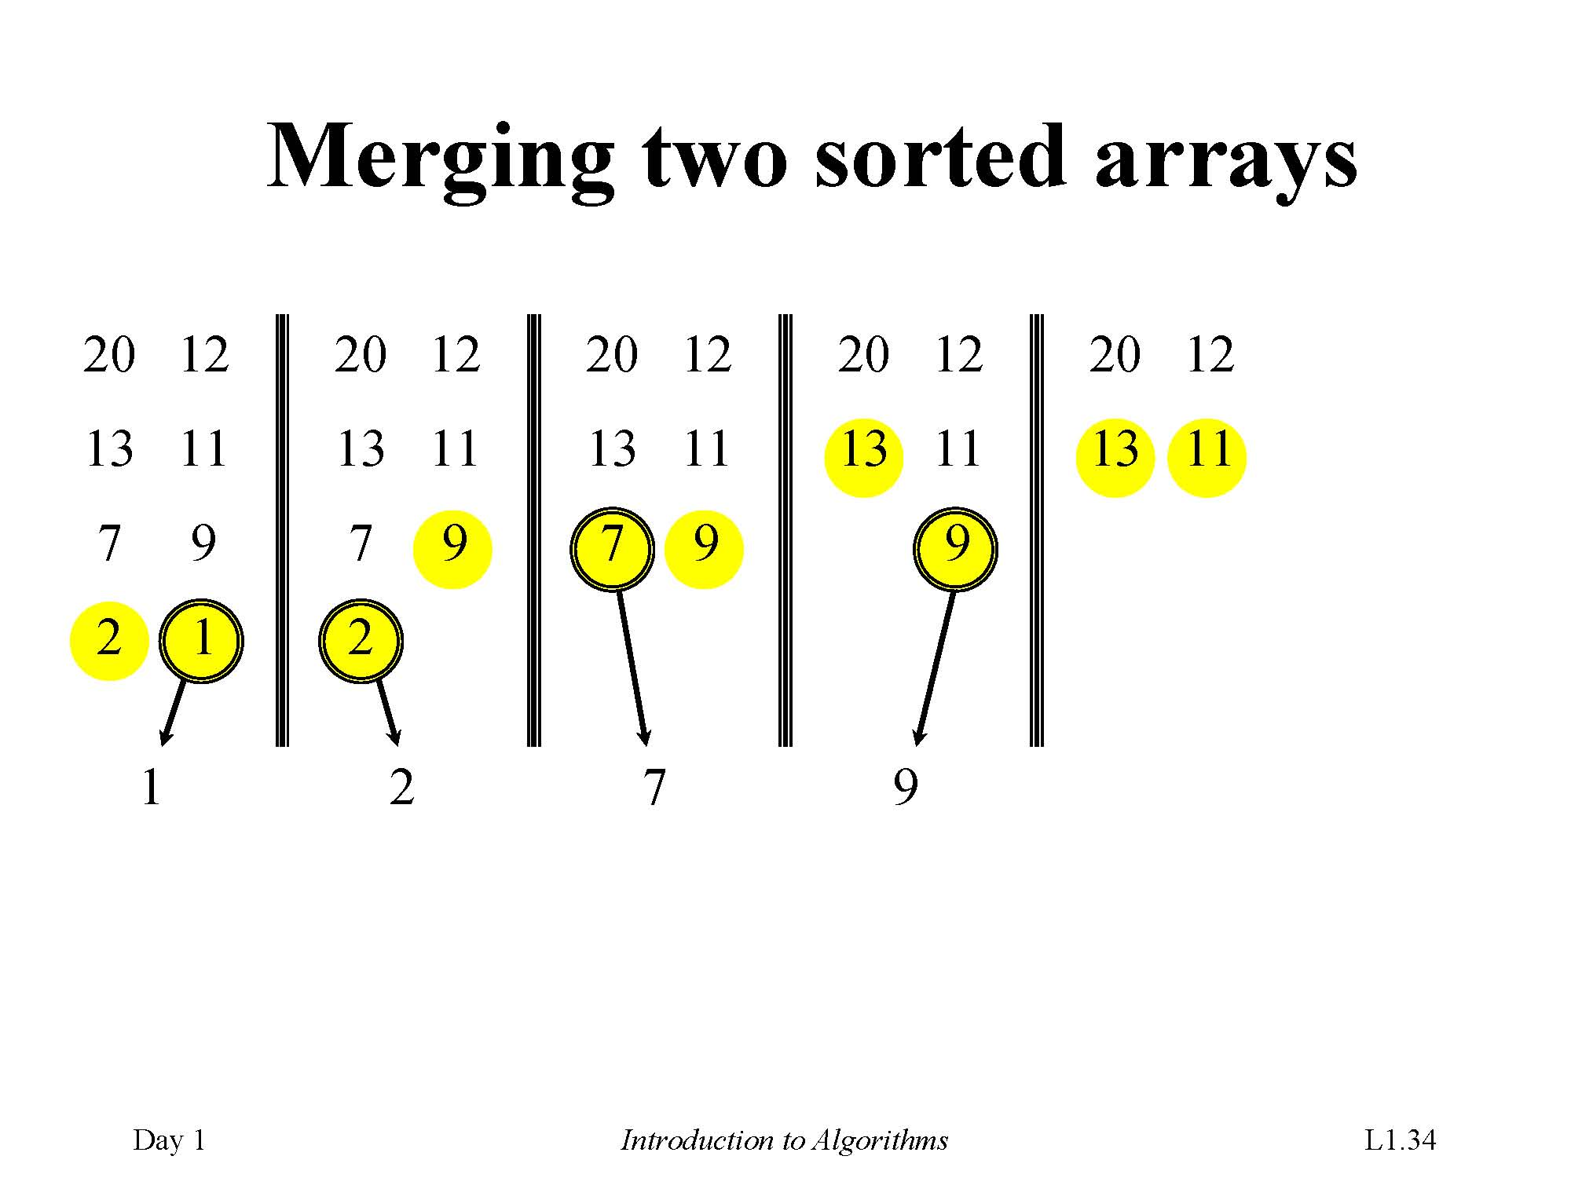

Slide 52
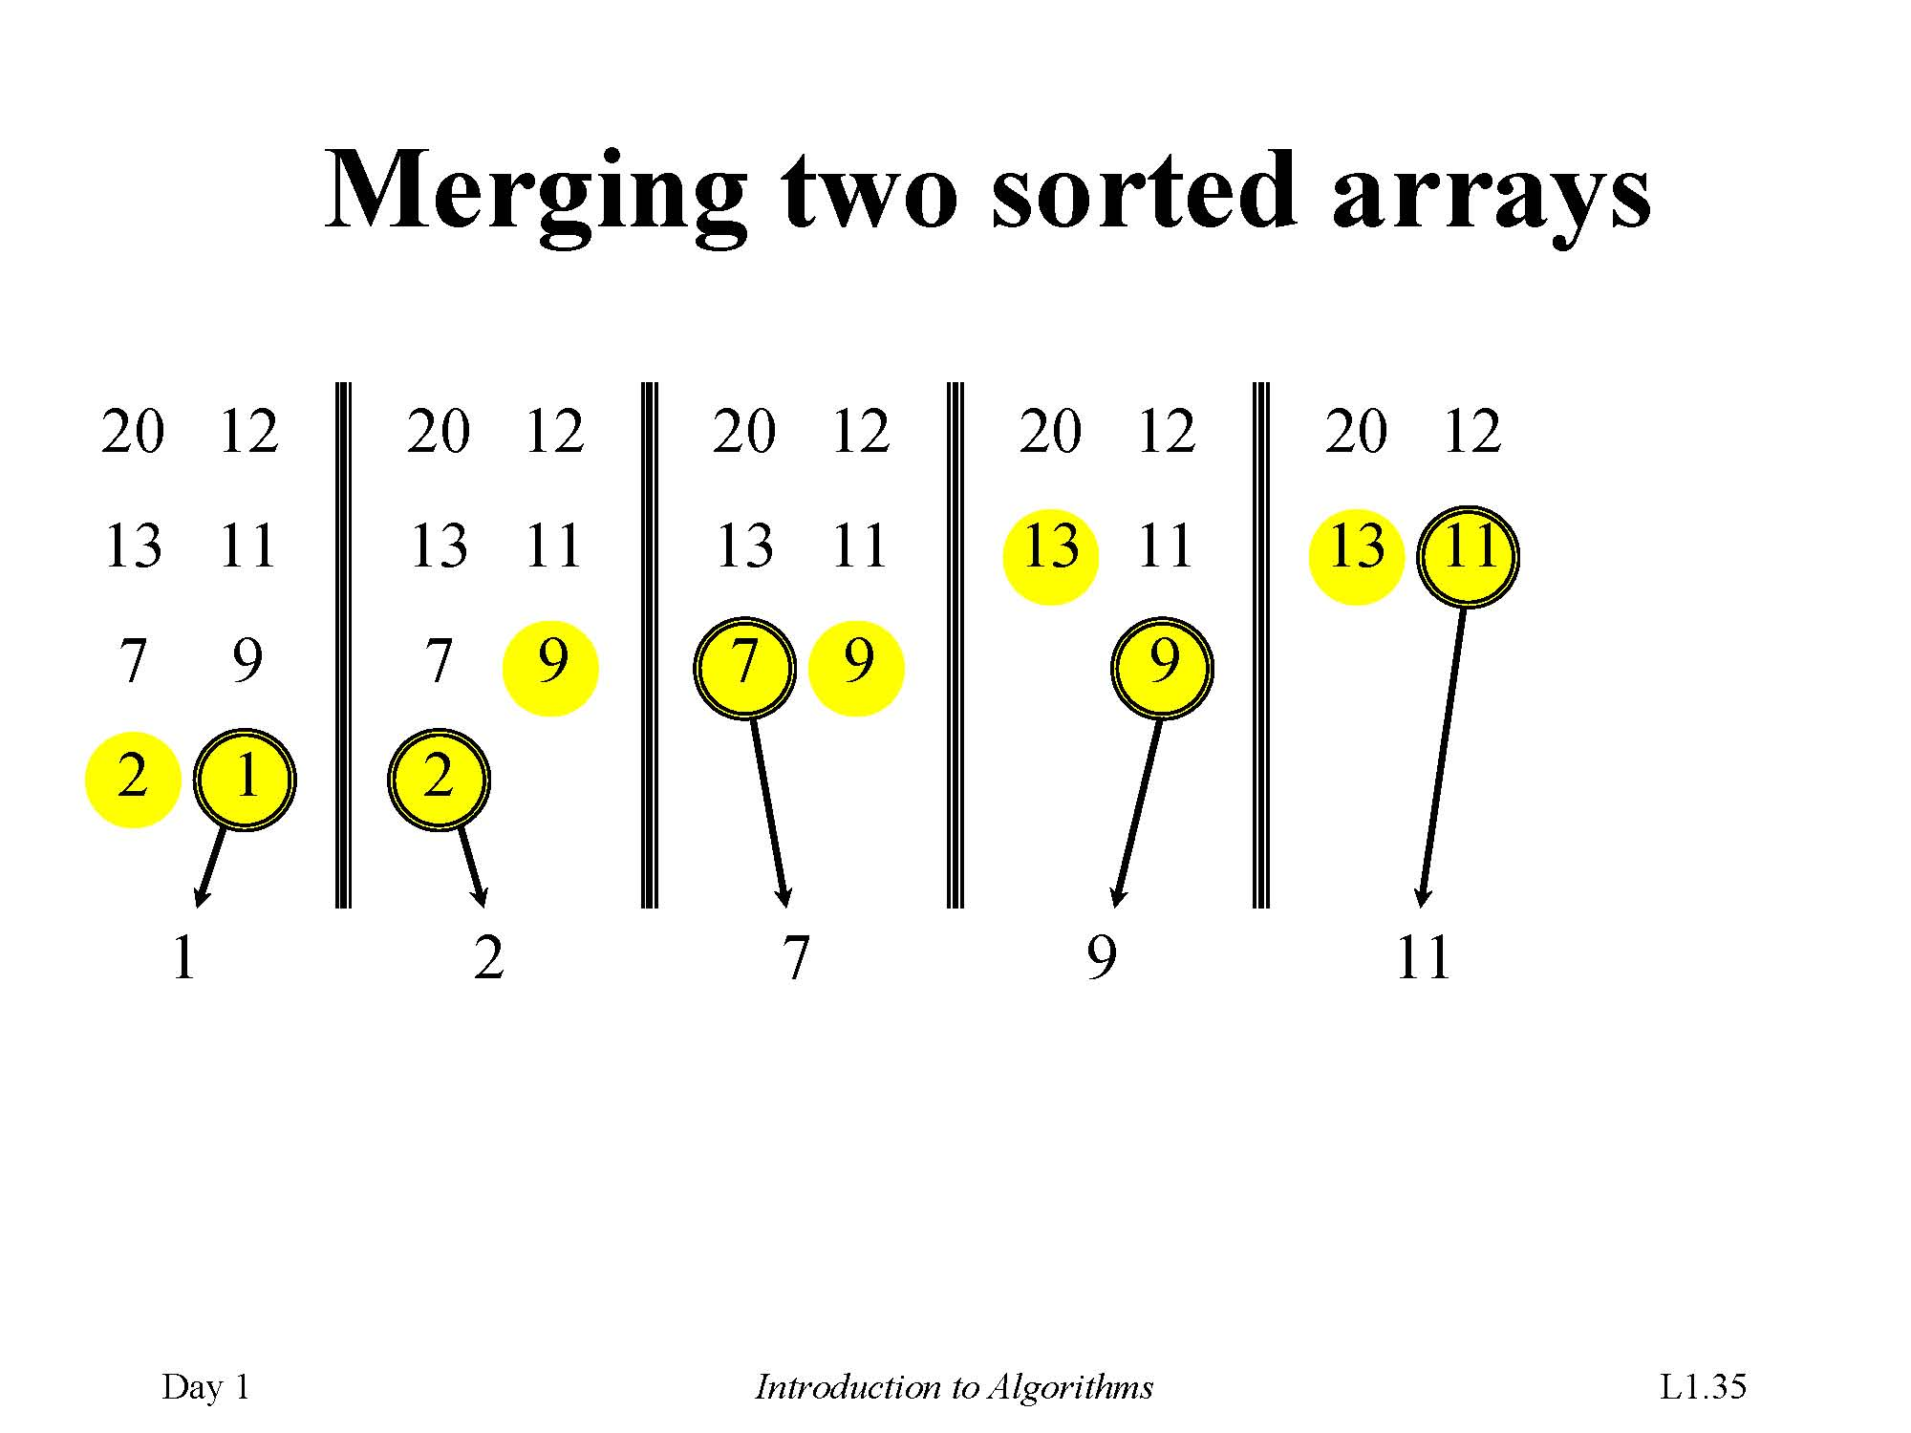

Slide 53
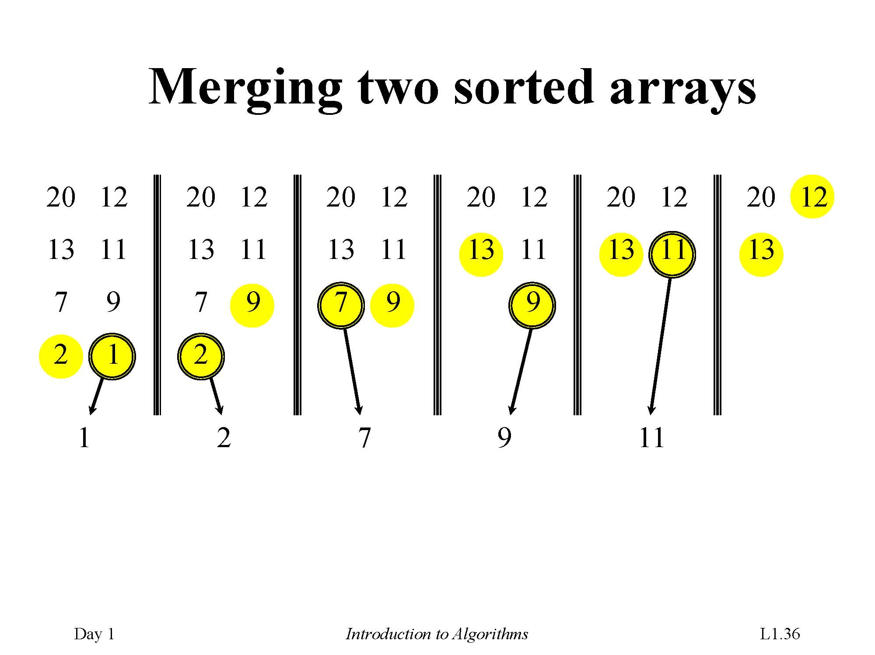

Slide 54
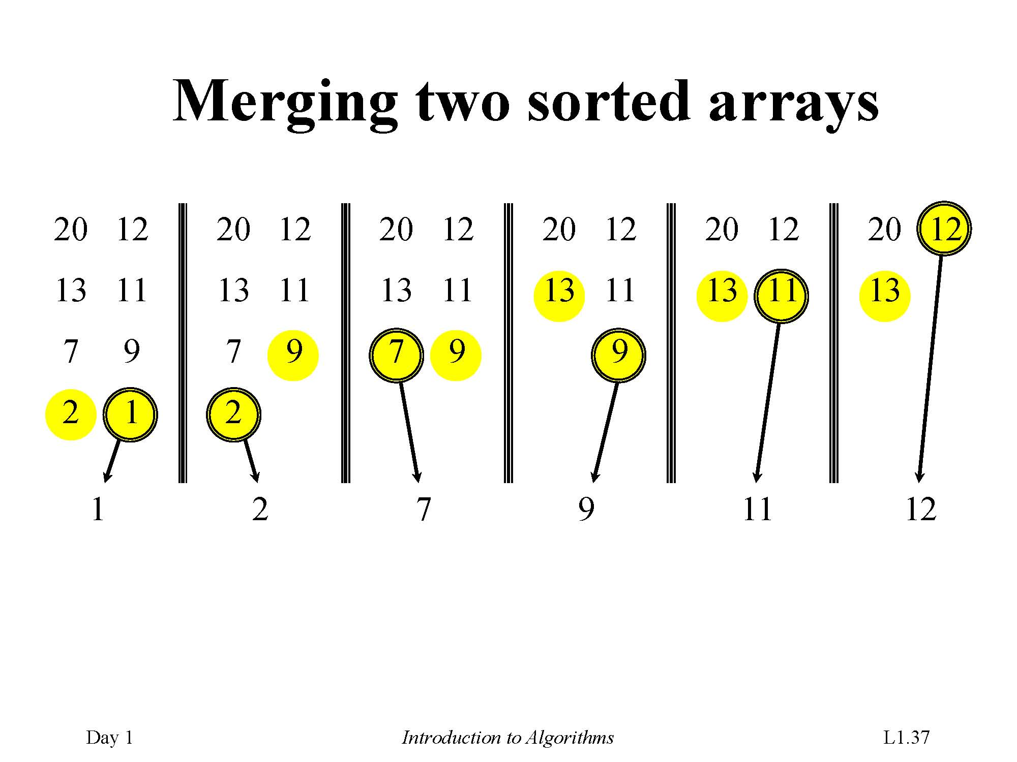

Slide 55
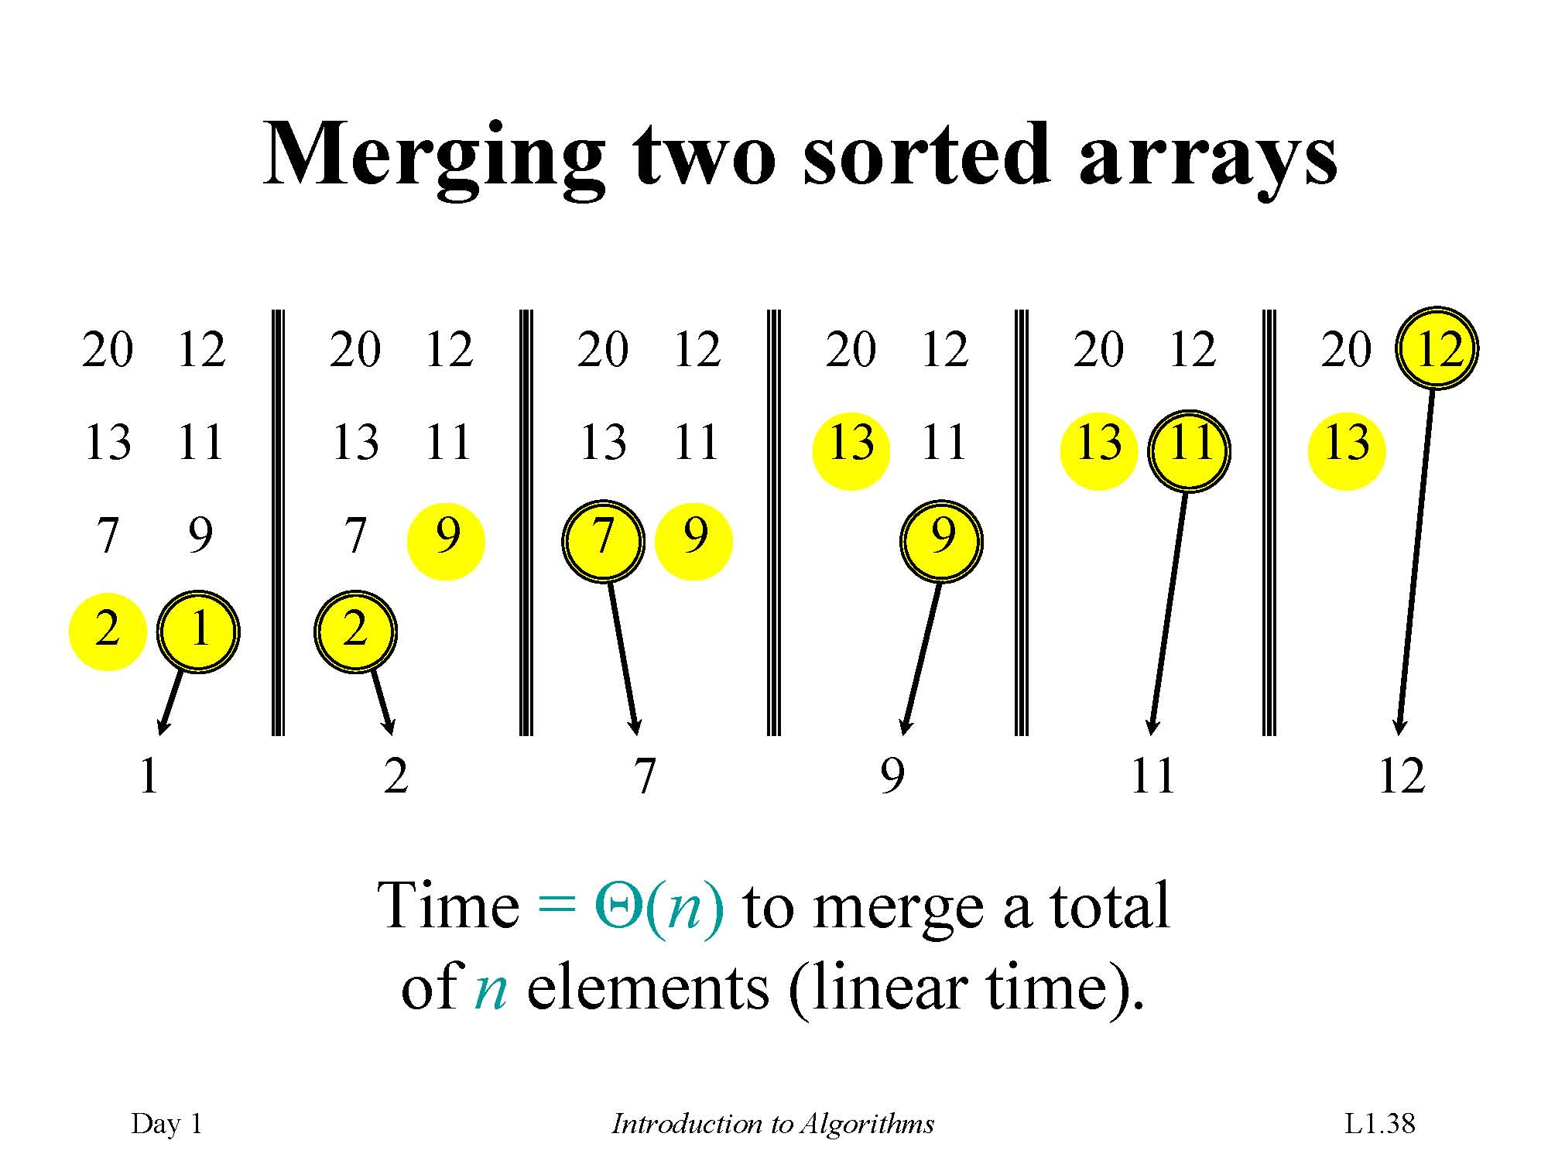

Slide 56
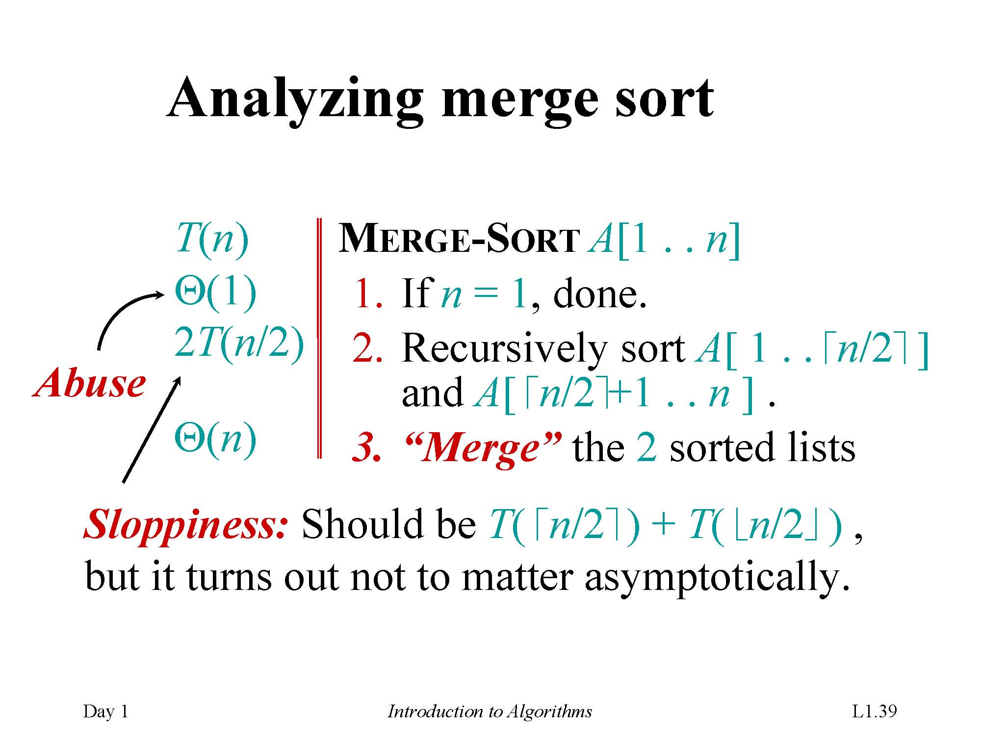

Slide 57
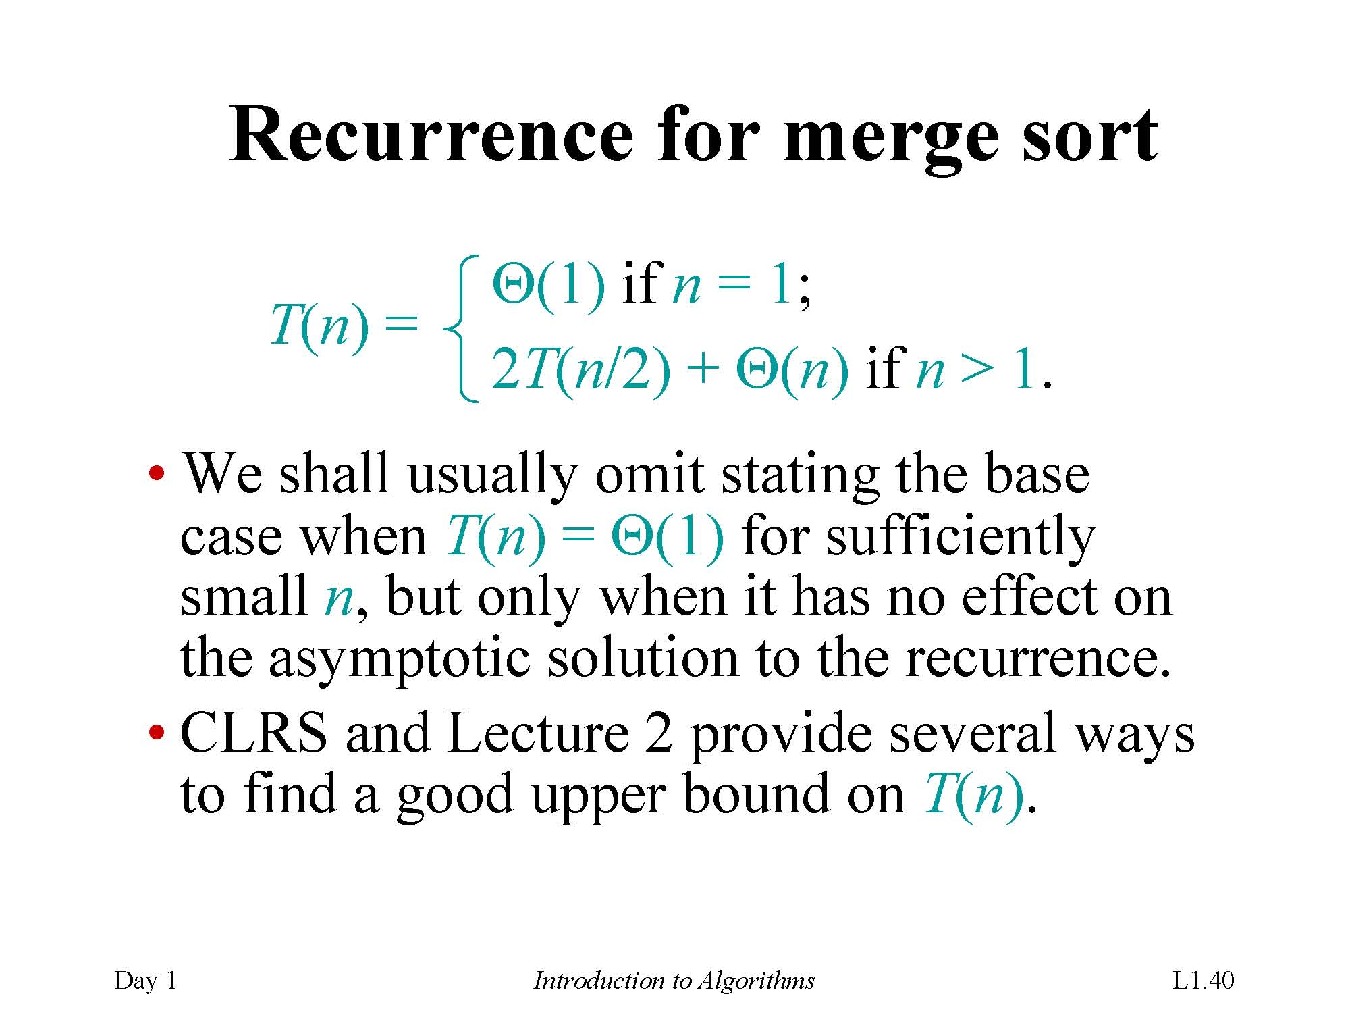

Slide 58
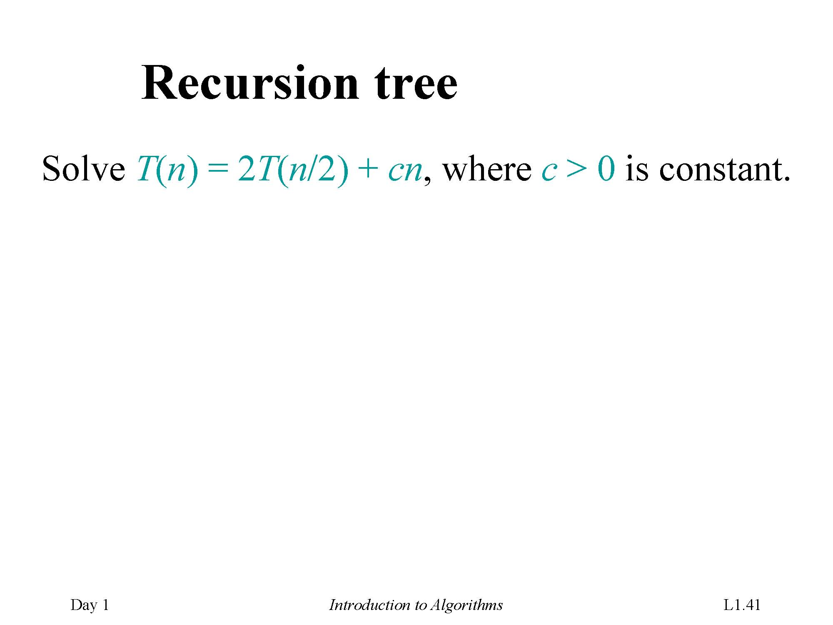

Slide 59
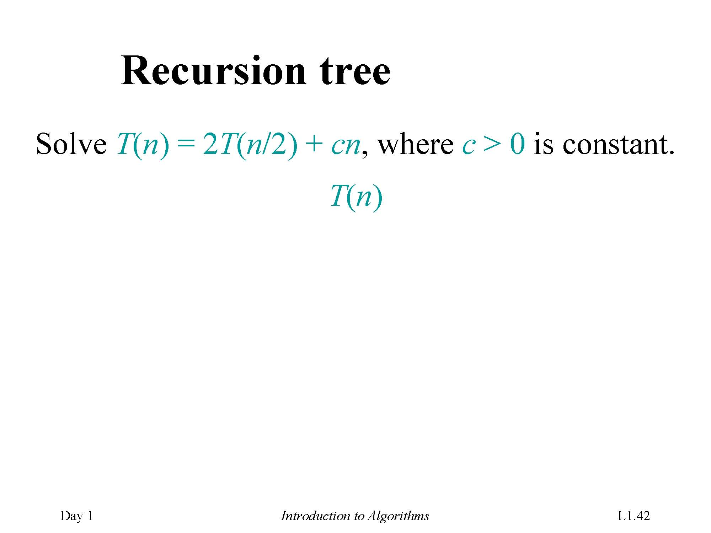

Slide 60
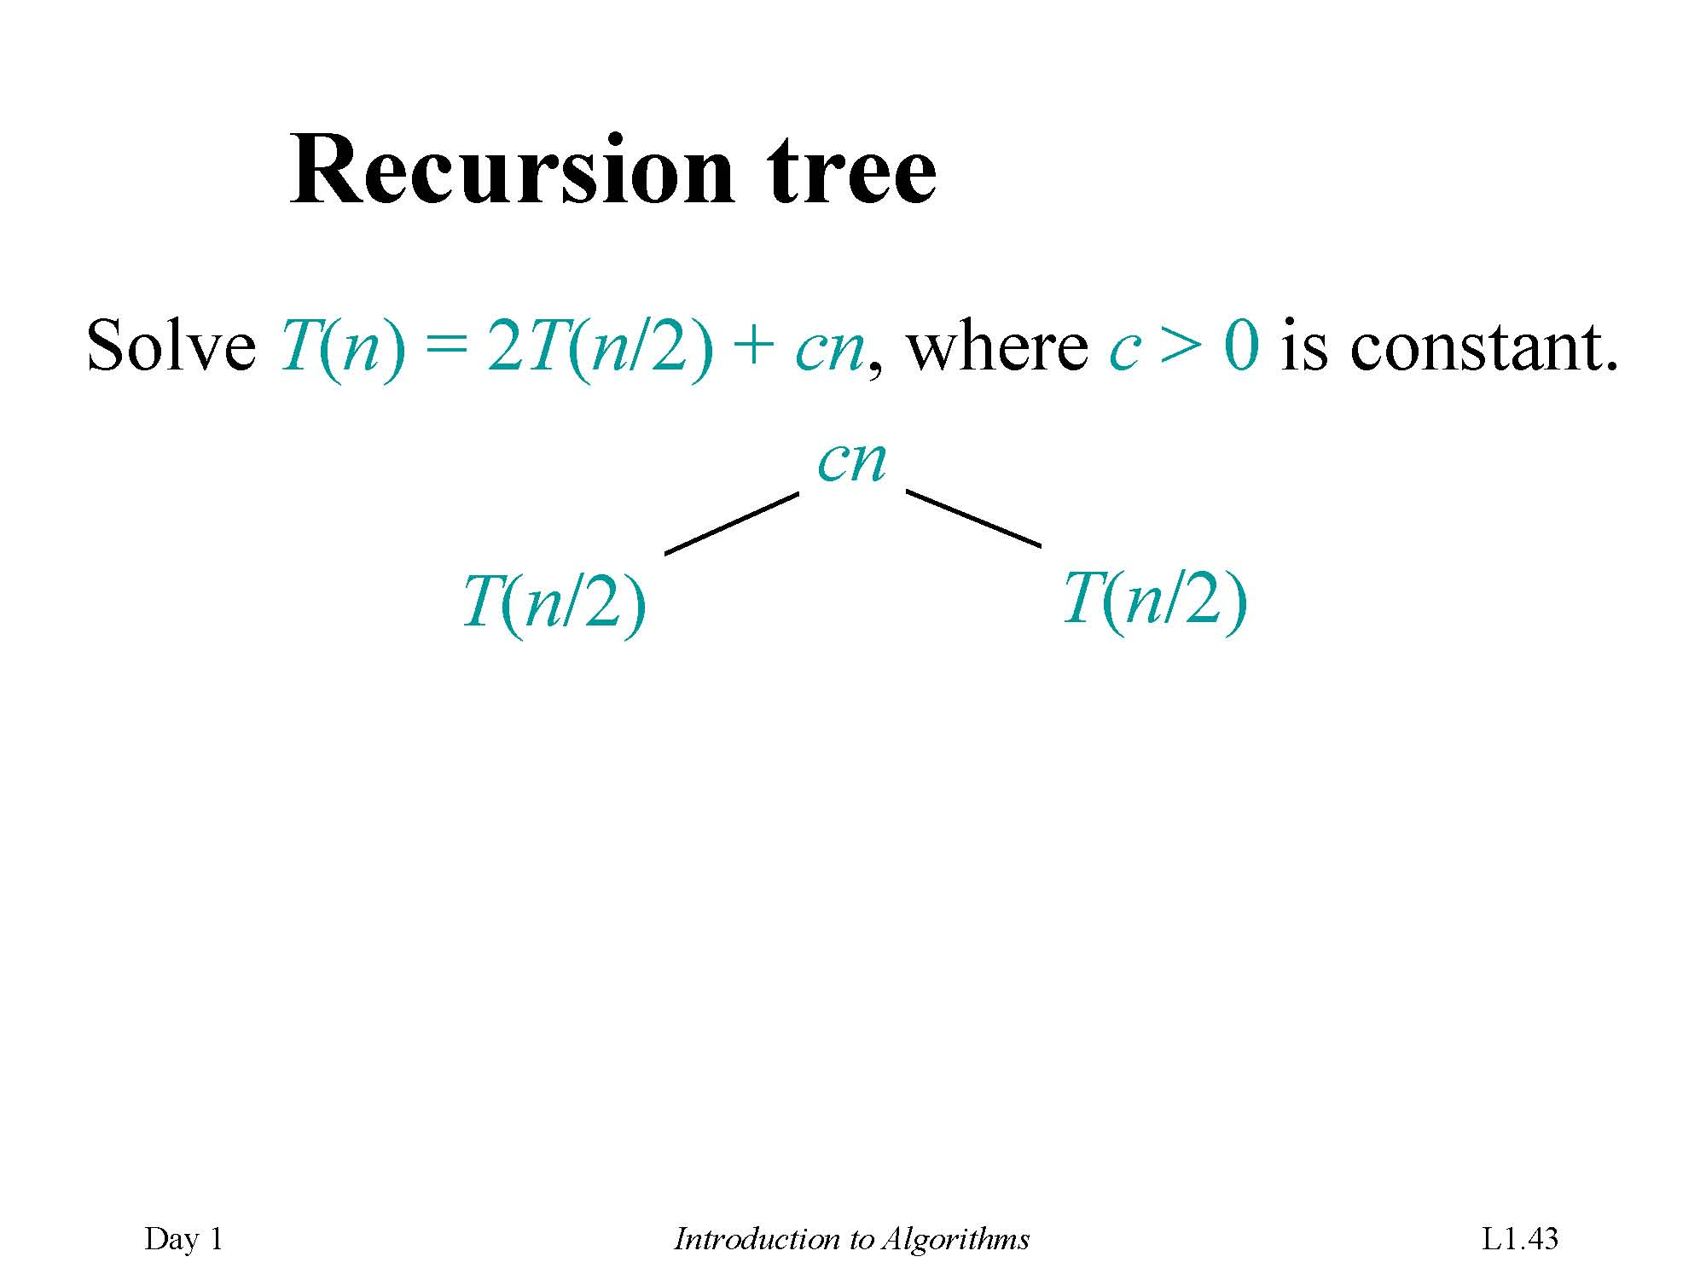

Slide 61
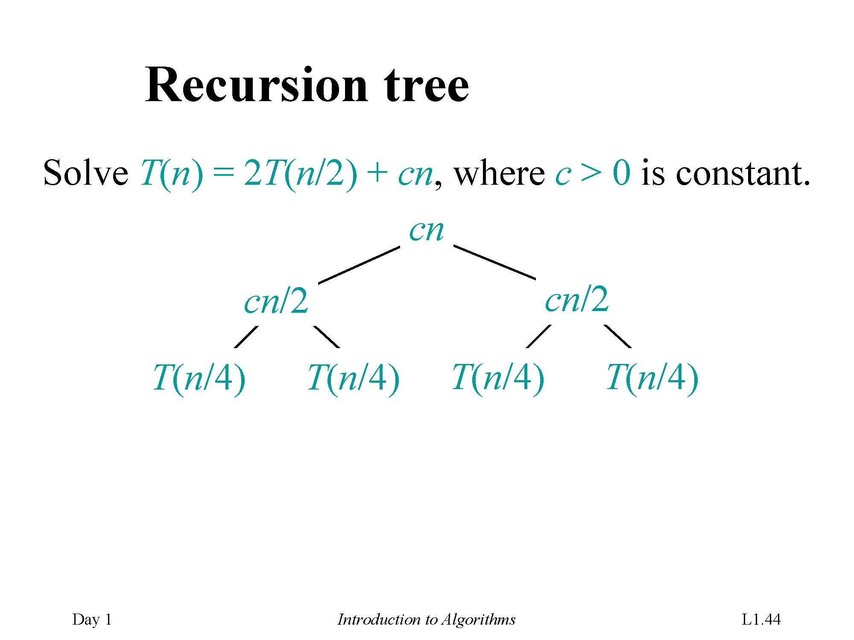

Slide 62
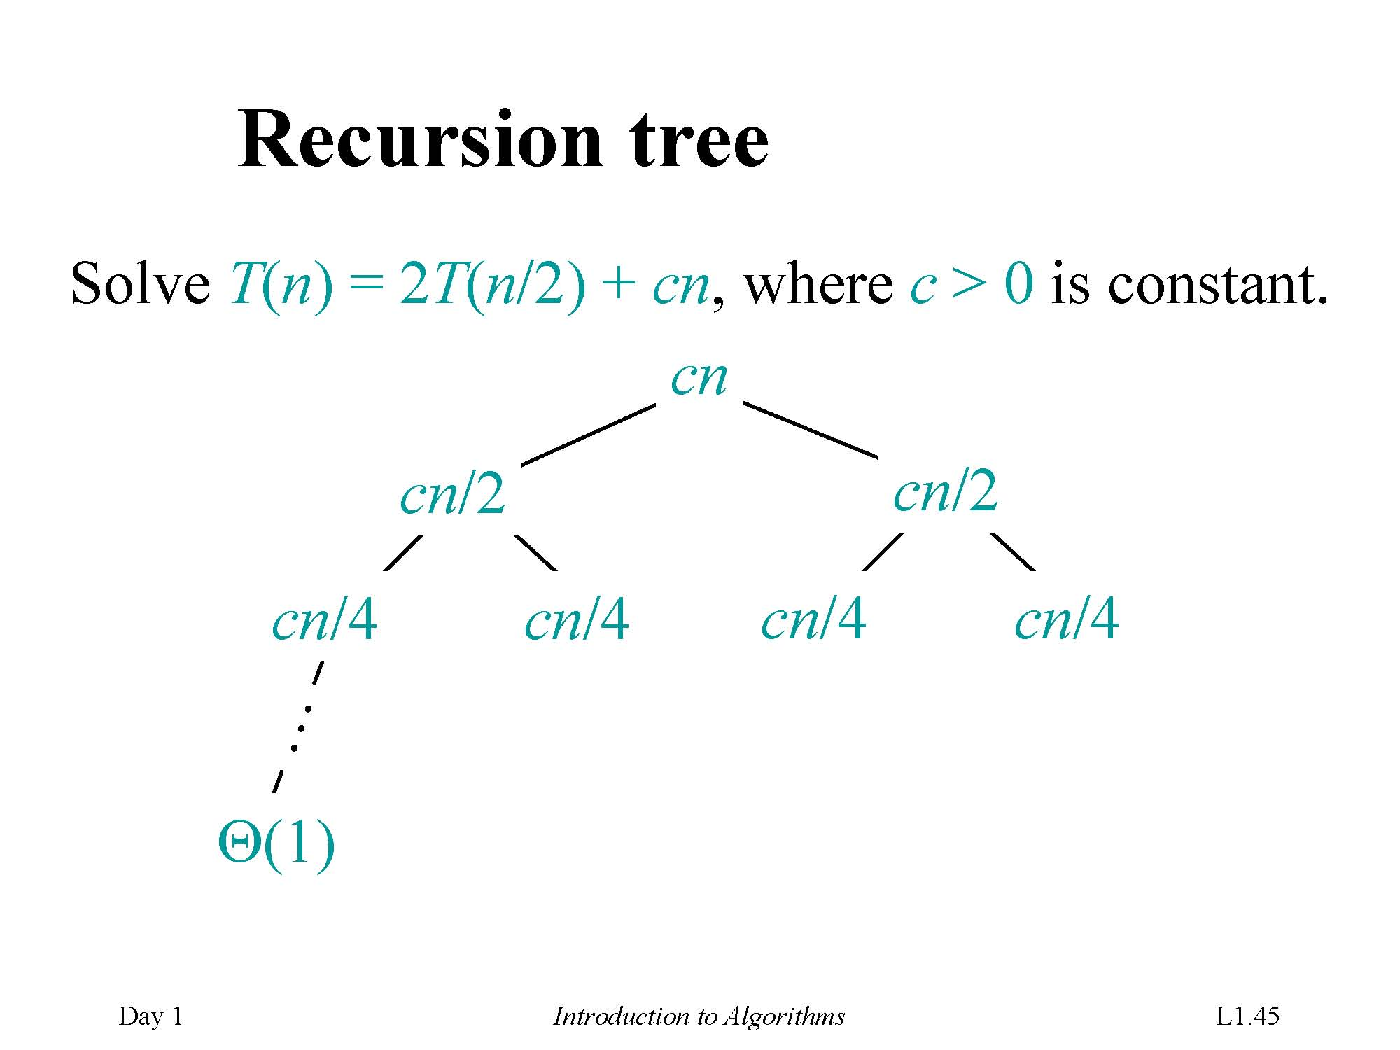

Slide 63
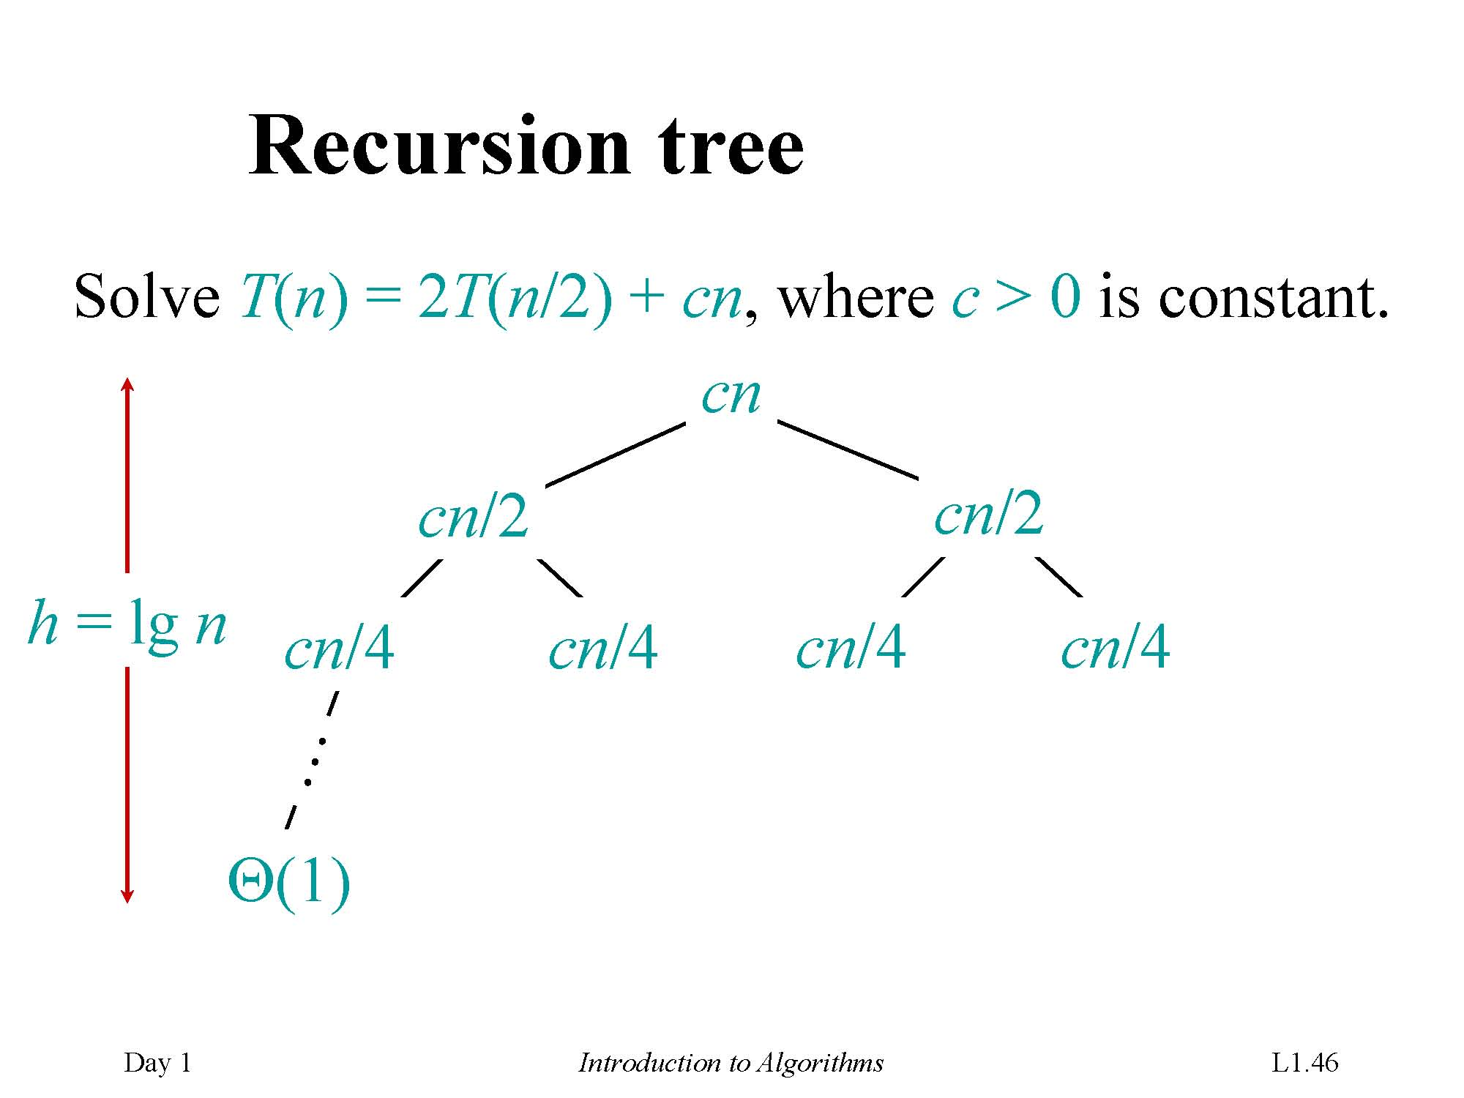

Slide 64
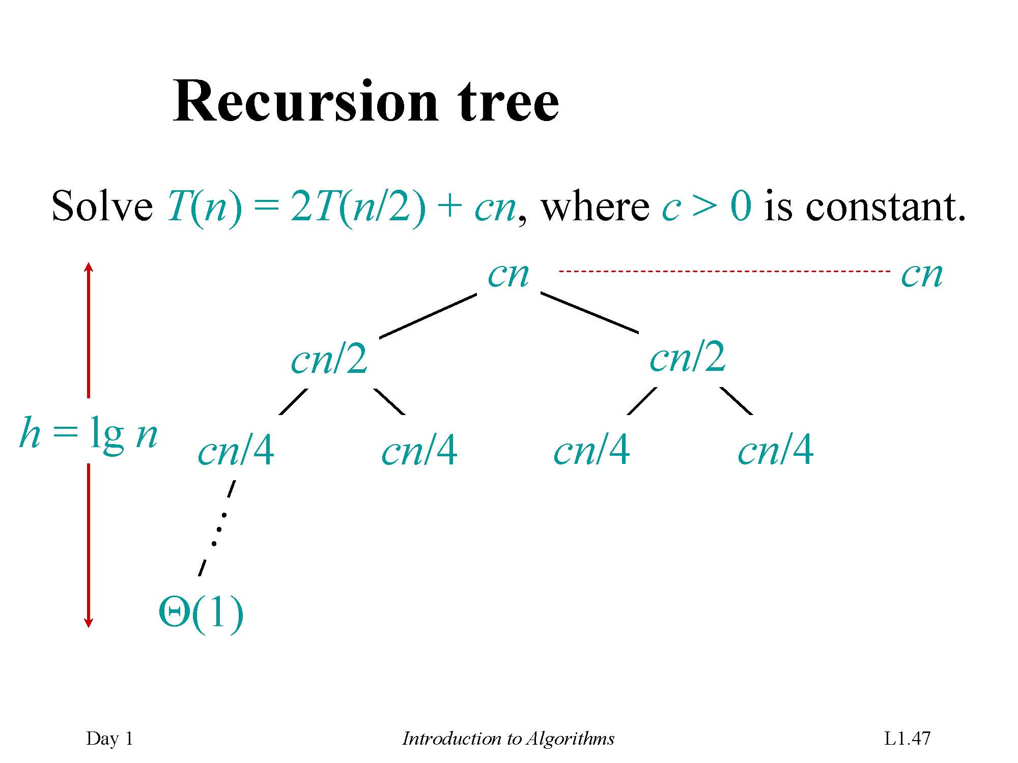

Slide 65
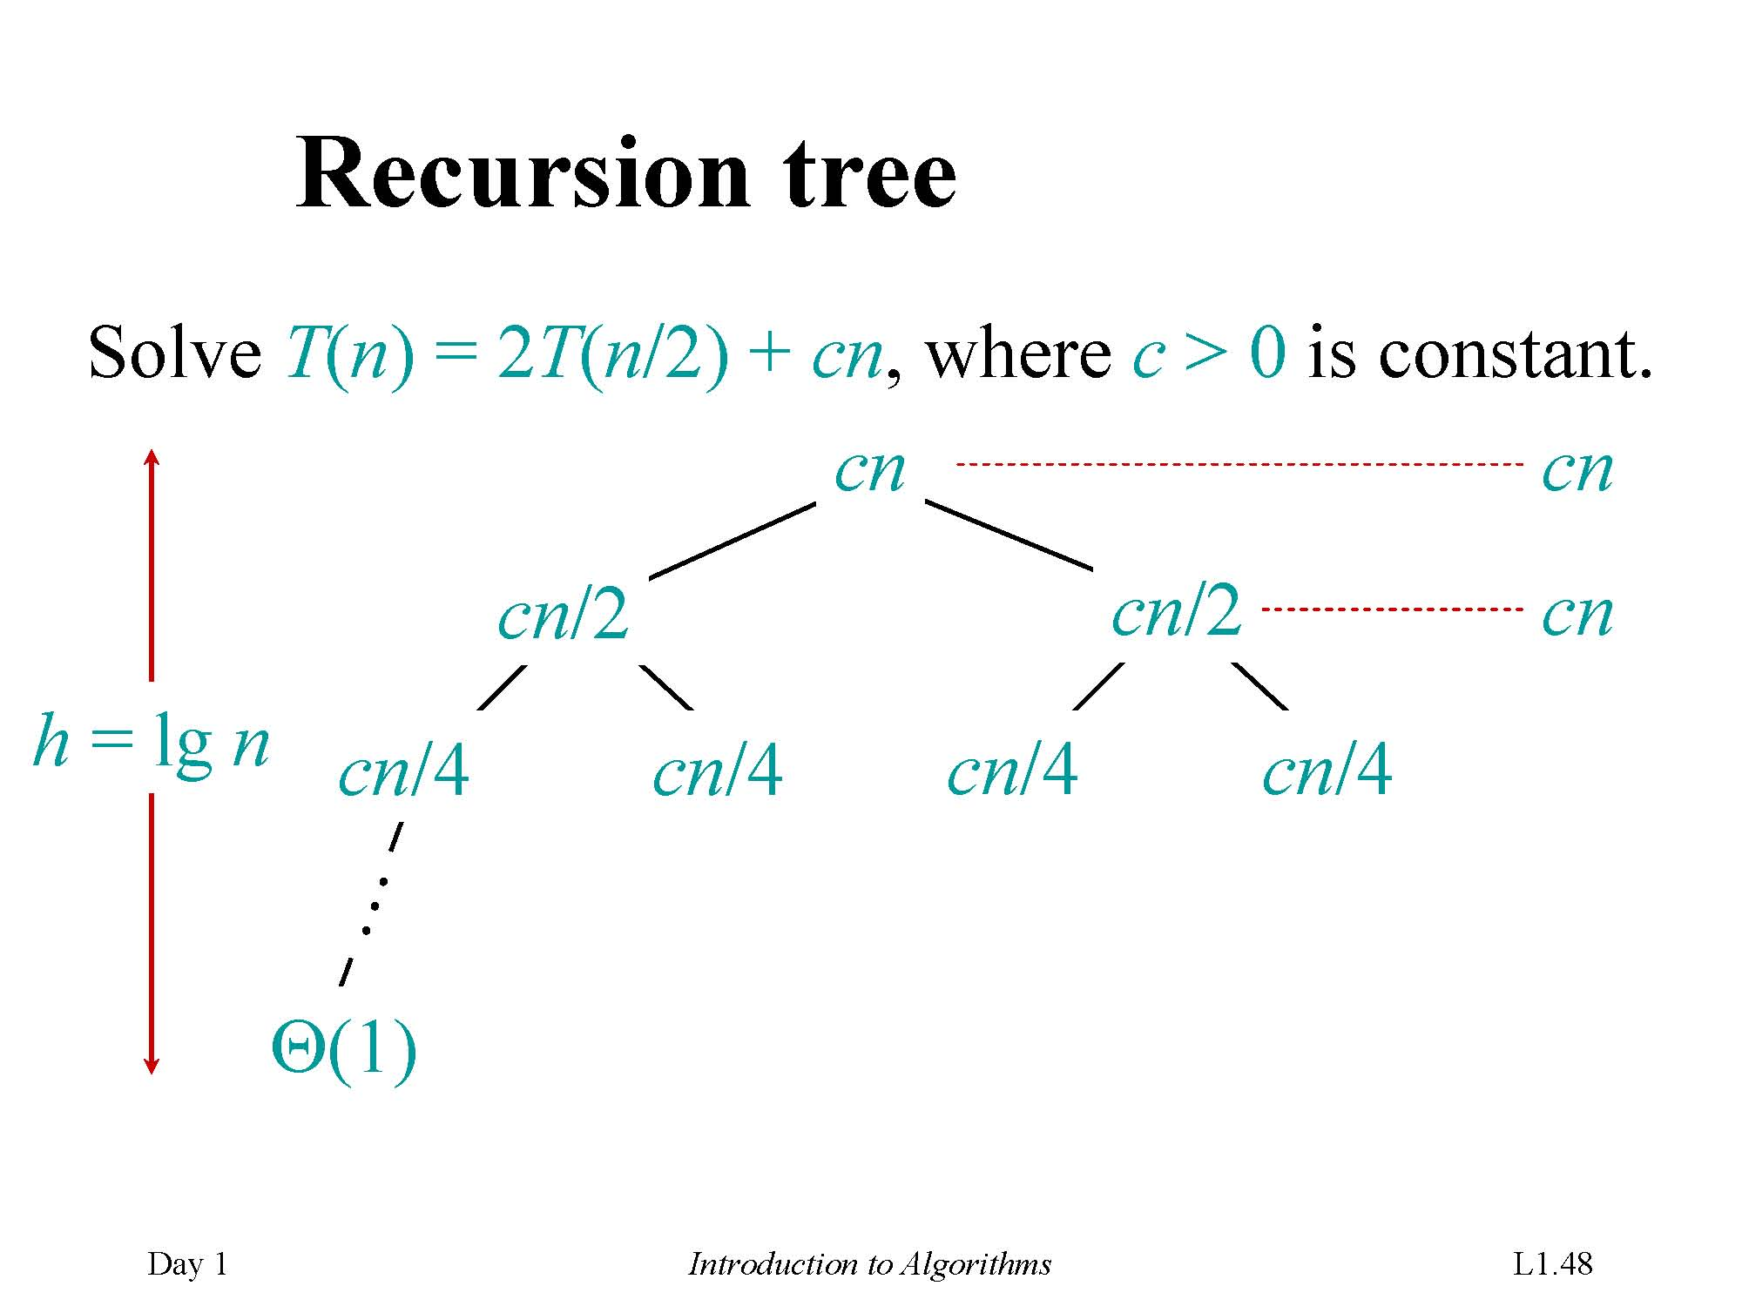

Slide 66
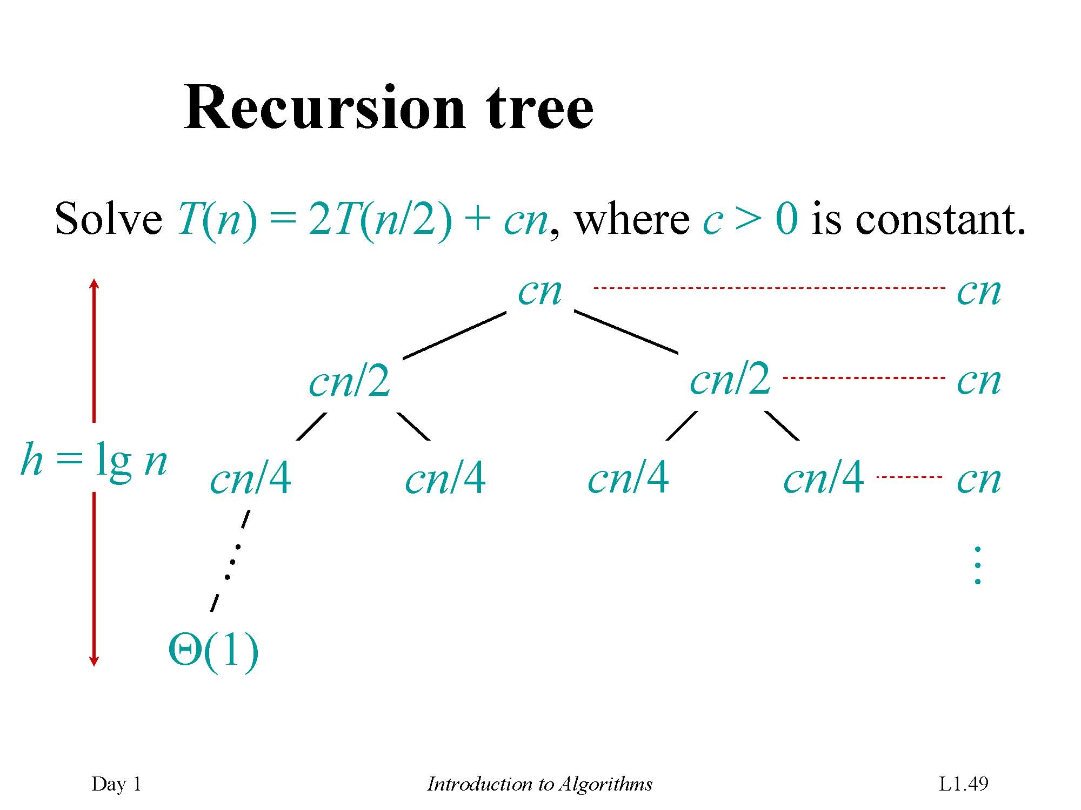

Slide 67
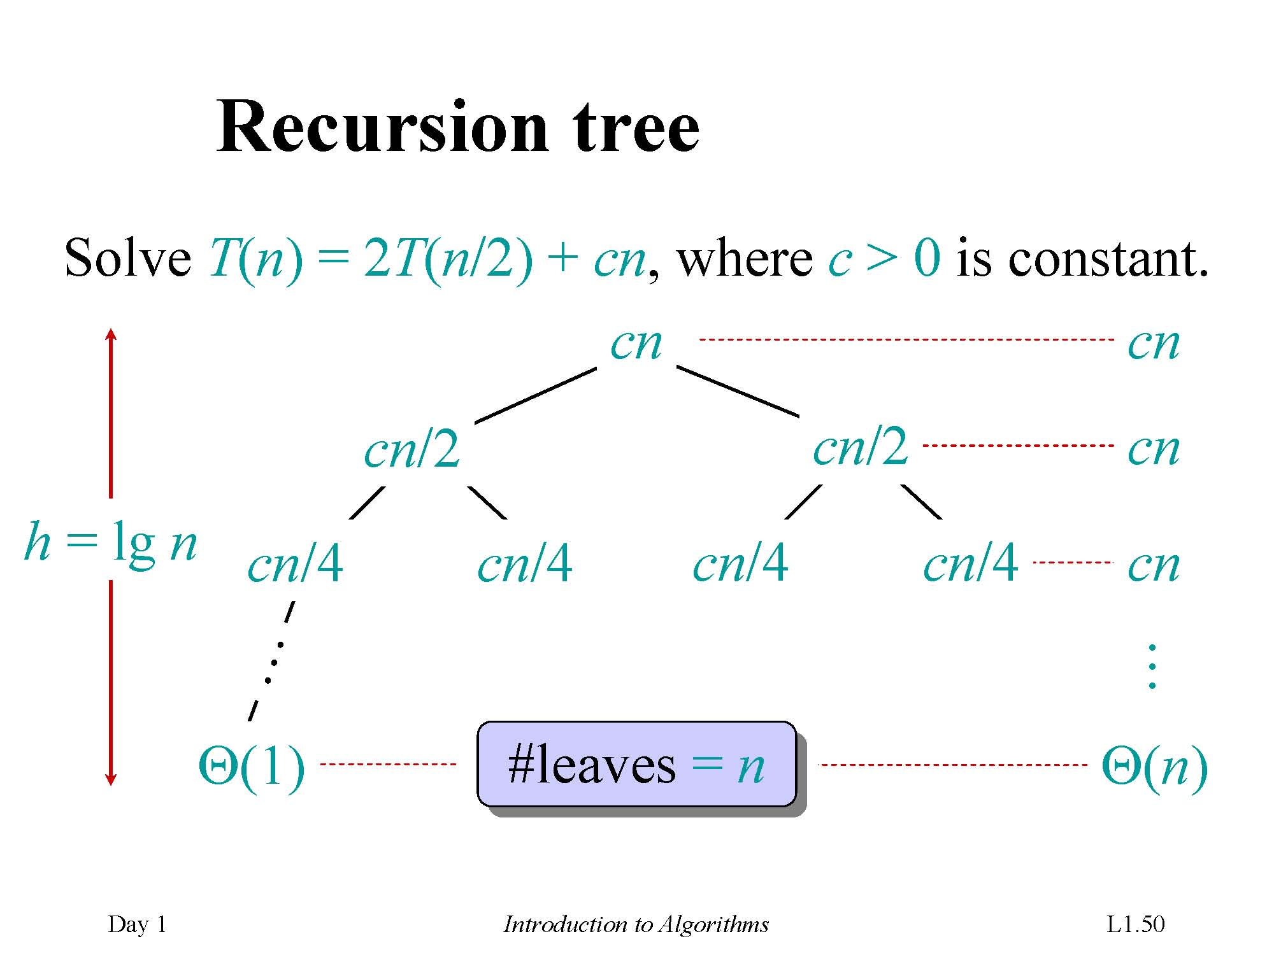

Slide 68
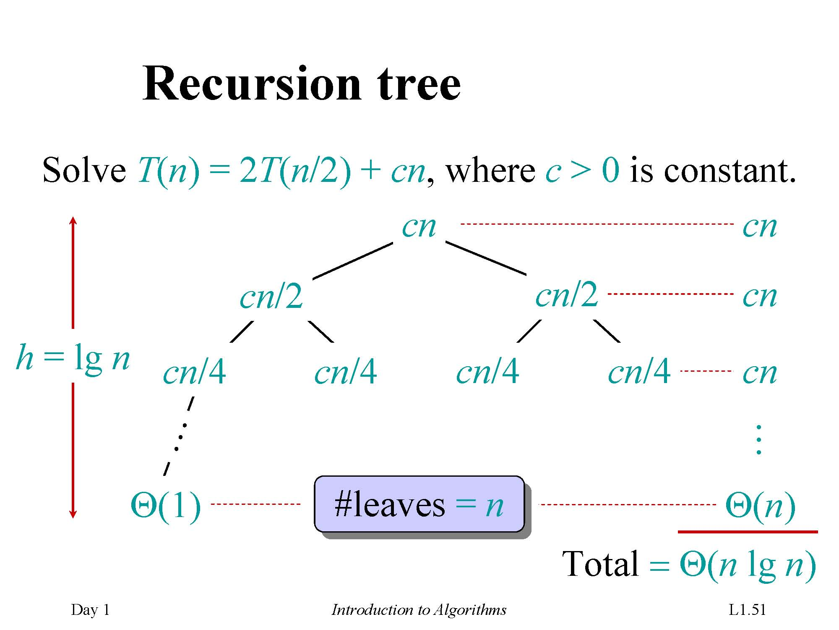

Slide 69
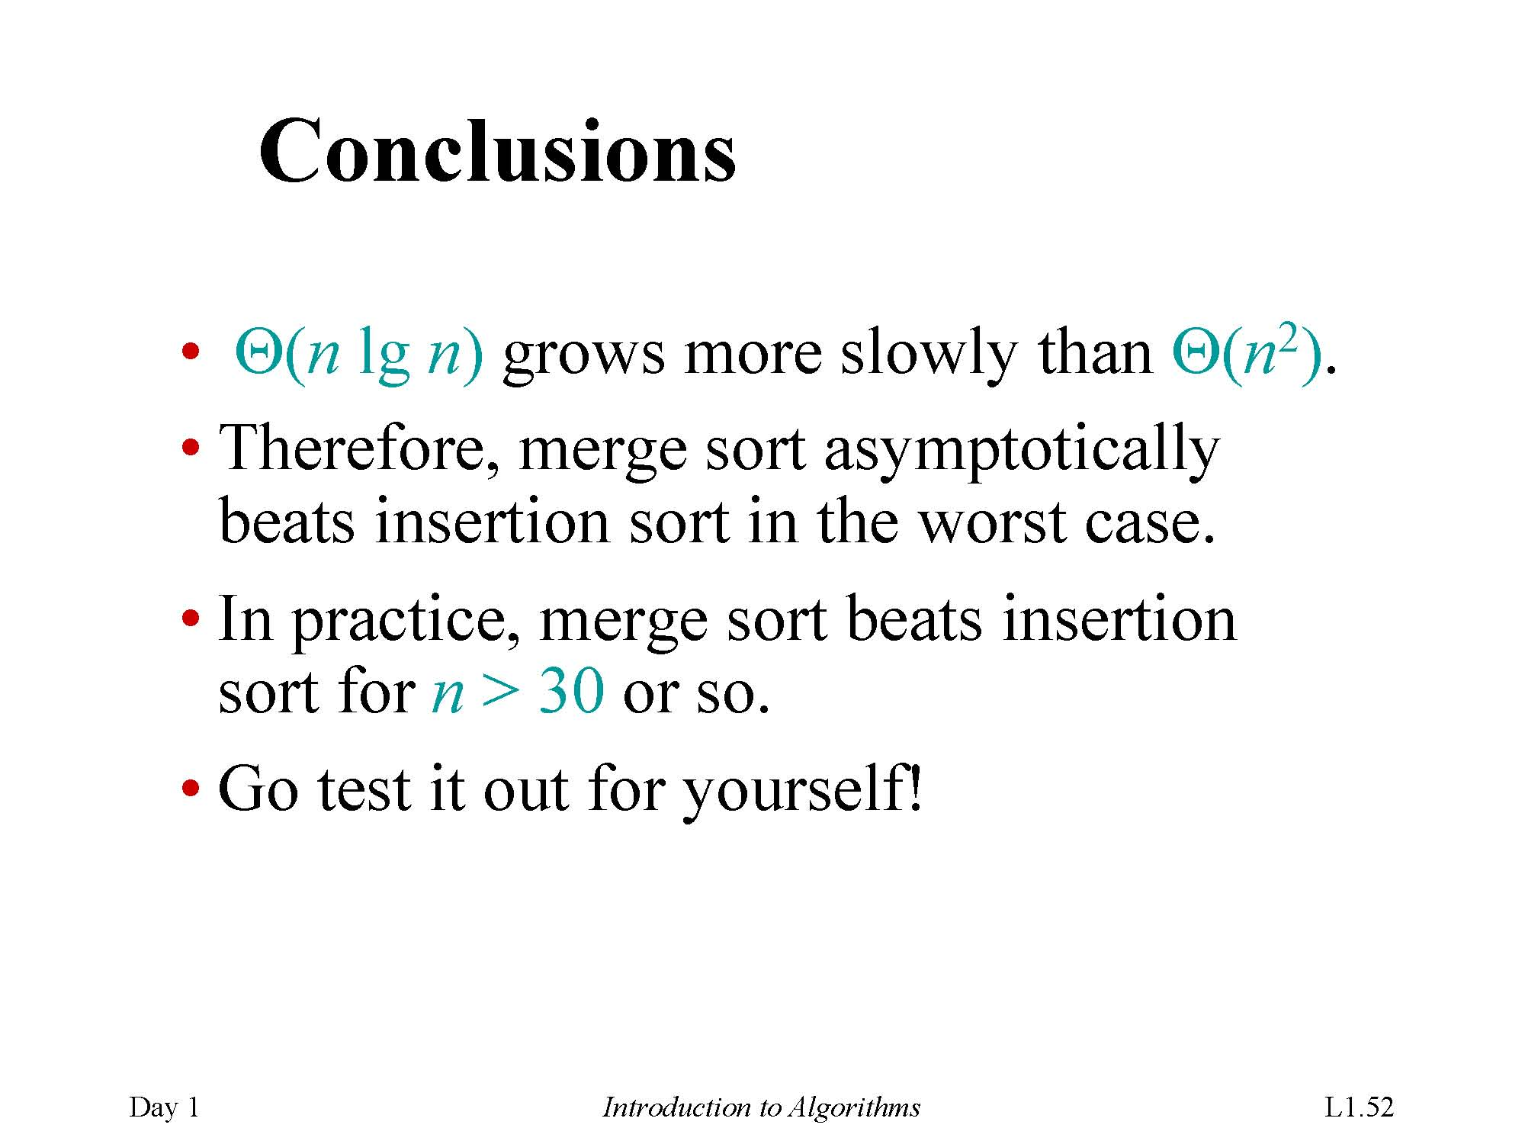

Slide 70
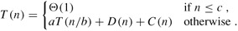
Time complexity for Divide-and-Conquer
Time complexity for Divide-and-Conquer
A recurrence
Divide-and-conquer paradigm
Divide the problem into a number of subproblems.
Conquer the subproblems by solving them recursively. If the subproblem sizes are small enough, however, just solve the subproblems in a straightforward manner.
Combine the solutions to the subproblems into the solution for the original problem.

Slide 71
Merge sort
MERGE-SORT A[1 . . n]
1. If n = 1, done.
2. Recursively sort A[ 1 . . ⎡n/2⎤ ]
and A[⎡n/2⎤+1 . . n ] .
3. “Merge” the 2 sorted lists.
Key subroutine: MERGE

Slide 72
Pseudocode conventions
Indentation indicates block structure:
Clarity
Similar to those in Pascal
The looping constructs:
while, for, and repeat
the conditional constructs:
if, then,and else
The symbol "▹" indicates that the remainder of the line is a comment.
A multiple assignment of the form i ← j ← e
Array elements A[1..j]=A[1], A[2], . . . , A[j].

Slide 73
Exercises
2.1-2 Rewrite the INSERTION-SORT procedure, nonincreasing instead of nondecreasing order
2.2-2 Selection sort: Give the best-case and worst-case running times of selection sort …
2.3-4 Insertion sort can be expressed as a recursive procedure as follows. Write a recurrence for the running time of this recursive version of insertion sort.

Slide 74
Exercises
2.1-2 Rewrite the INSERTION-SORT procedure, nonincreasing instead of nondecreasing order
2.1-3 Linear search: sequence of n numbers, and a value v.
2.1-4 Adding two n-bit binary integers-arrays

Slide 75
Exercises
2.2-2 Selection sort: Give the best-case and worst-case running times of selection sort in Θ-notation.
2.2-3 Linear search: What are the average-case and worst-case running times of linear search in Θ-notation?
2.2-4 Best-case running time: How can we modify almost any algorithm to have a good best-case running time?

Slide 76
Exercises
2.3-3 Mathematical induction: Use mathematical induction to show that when n is an exact power of 2, the solution of the recurrence T(n)=2T(n/2)+n,T(2)=2 is T(n)=nlgn.
2.3-4 Insertion sort can be expressed as a recursive procedure as follows. Write a recurrence for the running time of this recursive version of insertion sort.

Slide 77
End of Chapter
《算法分析与设计》课程组
重庆大学计算机学院

